Slide 1


HPC Analyses with Code Versioning
How to combine Rivanna and Github
for better data science neuroscience
Mark J. Lawson, PhD
Senior Biostatistician
Department of Neuroscience
Center for Brain, Immunology, and Glia (BIG)

Slide 2
Goals
Understand the why and how of using a code versioning system like git / Github
Know how to get started with your project on UVA’s high performance cluster Rivanna using a Unix terminal
How to submit a job that requires high performance to Rivanna using slurm

Slide 3


Three main technologies
git
Unix
slurm

Slide 4
git is a way to store and version control your code
“A system that tracks every change to your files over time, like an unlimited undo button with a complete history”
Provides an interface for who made the changes and why they were made
Allows for easy collaboration between a team of researchers
Can roll back to a previous version as they are all preserved
Can ensure reproducibility of an analysis
A central repository (Github, Gitlab) that can be shared amongst team members and external collaborators
Even for just an individual to share between different computers …
git is meant for code and NOT data

Slide 5

Commonly used git commands
git init/clone
Create a new git repository (init) or download a repository (clone)
git add
Add a new file to be tracked by git version control
git commit
Save changes to the file and a comment about the change to the repository
git push
Save all commits to the repository to an external location
git pull
Download all changes to the repository to your local version
git fork
Create a copy of a different repository to make your own modifications

Slide 6
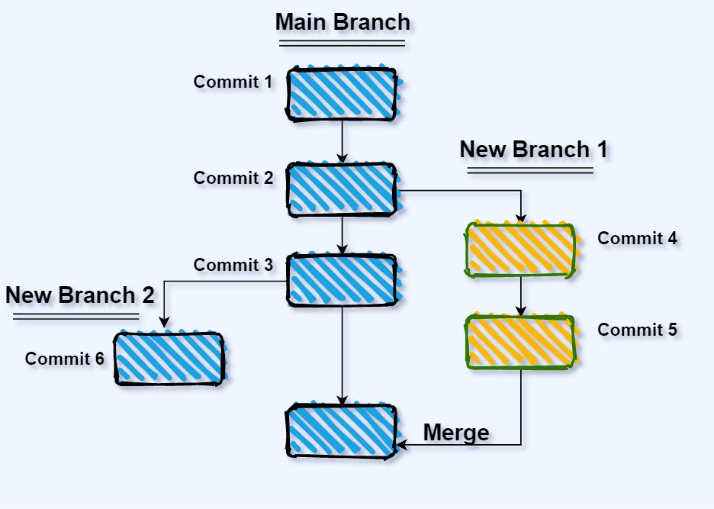
More advanced git commands
git branch
Create a branch in the code, so crazy new ideas can be experimented with
Main branch of the code is unaffected, just in case those crazy new ideas end up breaking things
git merge
Hey, looks like that crazy new idea does work! Let’s merge it back in with the main branch
git automates merging in the changes (and typically does a good job) but might require hand-holding if changes are complex

Slide 7
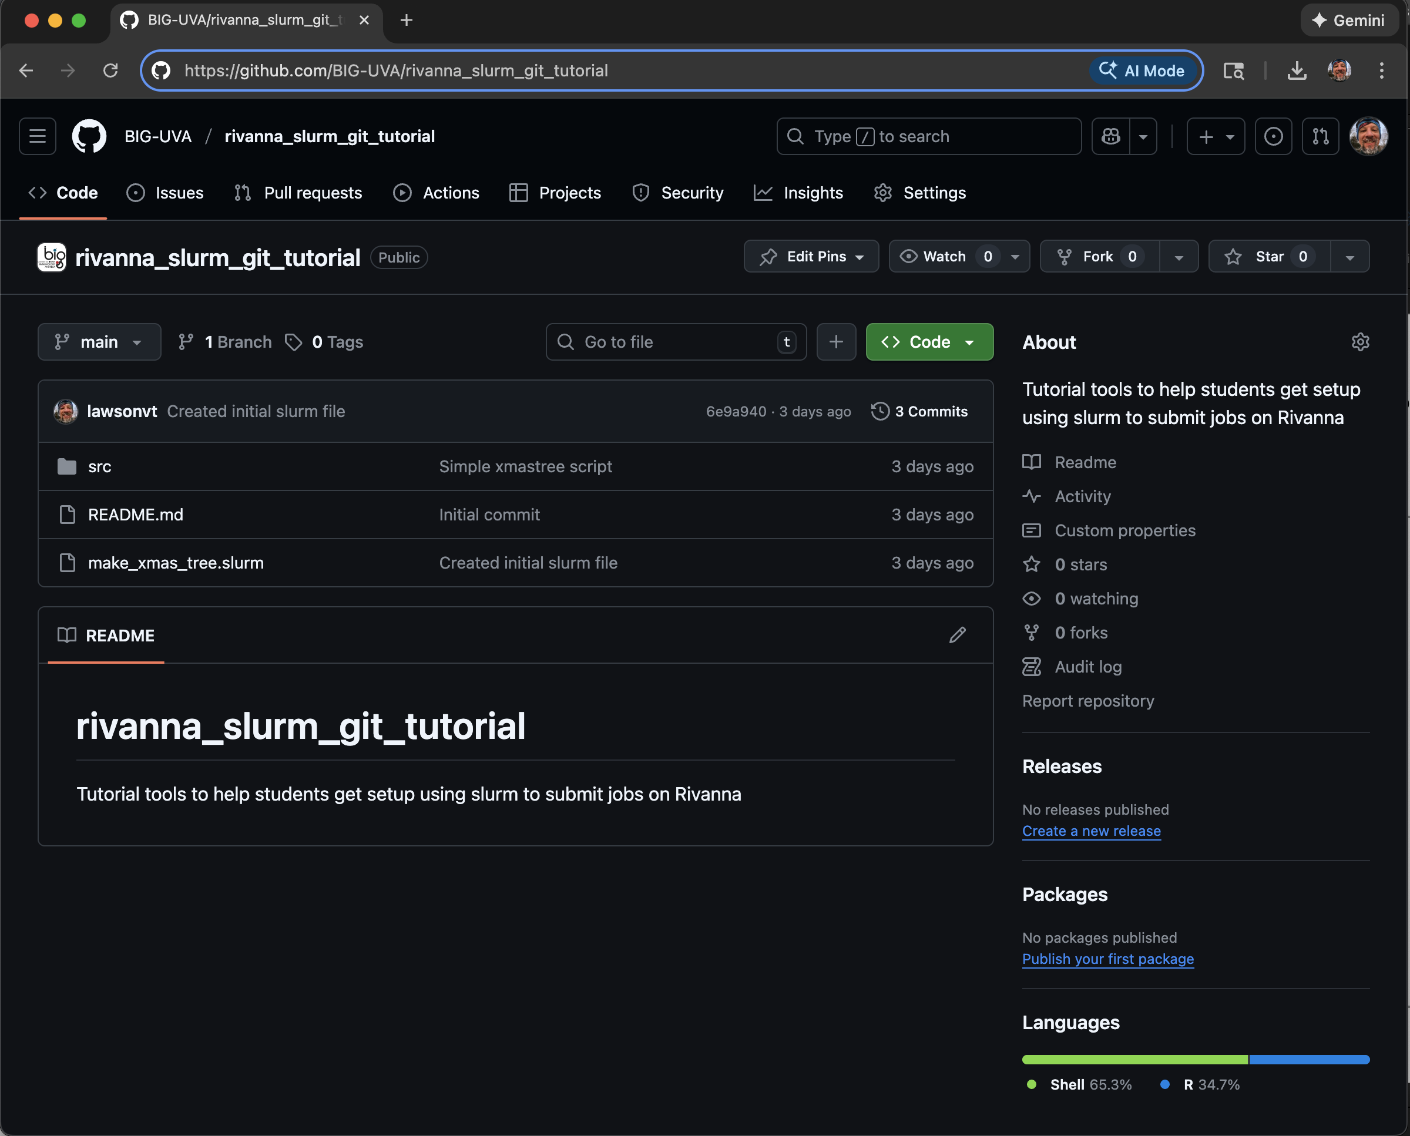
Github is online storage to store and share code using git
An online storage space that serves as the hub for your code
Free to join, free to store code
Especially if you are publicly sharing your code
Private code has restrictions and might require payment
User controls who can make changes to code

Slide 8
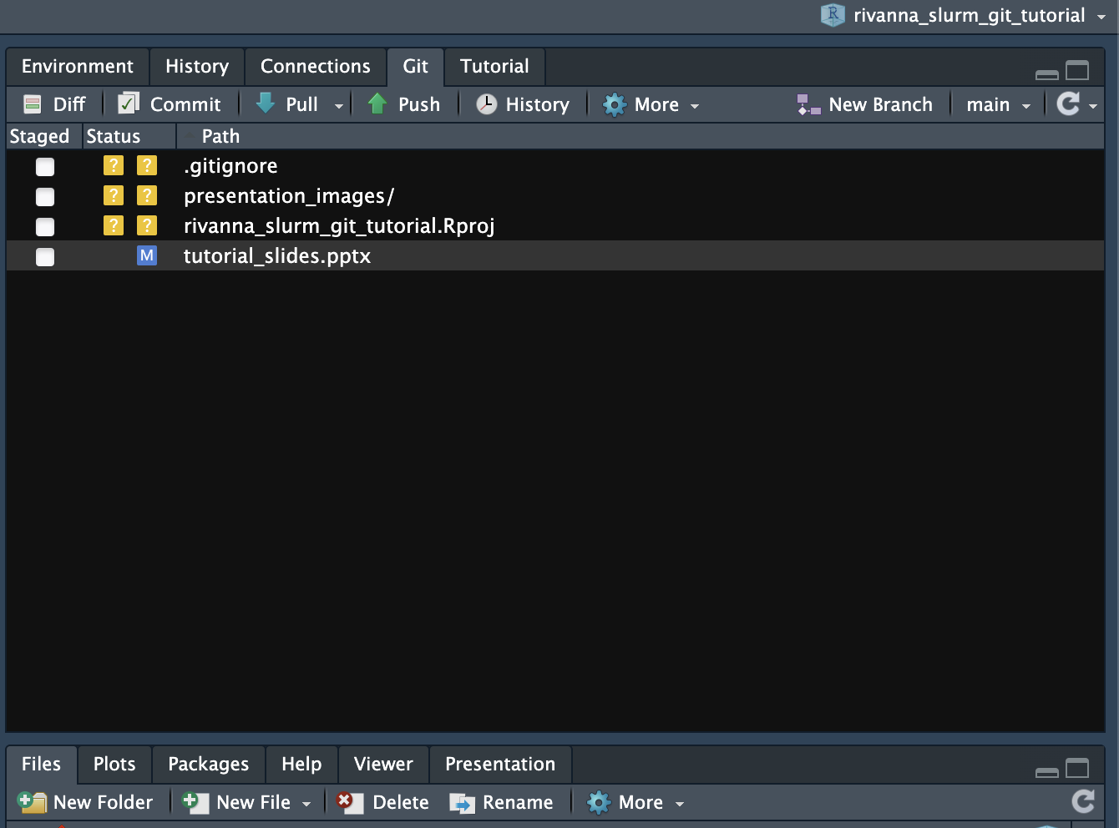
git / Github integrates well with RStudio
Initializing a project with git in Rstudio creates the git control panel
This panel gives you controls for all commonly used git commands
Visual overview of files and untracked changes
No command line needed!

Slide 9
Tutorial Part 1
If you don’t have a Github account, create one
Go to the Github repository https://github.com/BIG-UVA/rivanna_slurm_git_tutorial
Fork the repository into your personal repositories
Start a new project in Rstudio, pointing towards your forked repository

Slide 10
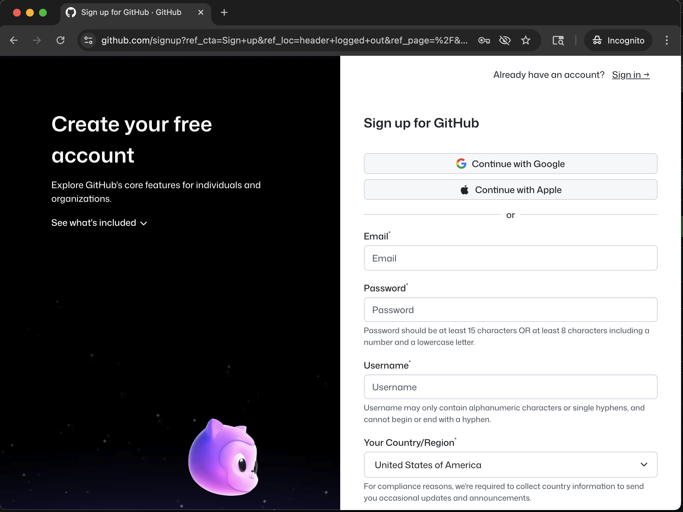
Create a Github account
In order to be able to create repositories, you need a Github account
Requires you to pick a username
Due to collaboration and potential future employment, make sure to pick one that is SFW

Slide 11
Login and fork the tutorial Github repo
https://github.com/BIG-UVA/rivanna_slurm_git_tutorial
Click this

Slide 12
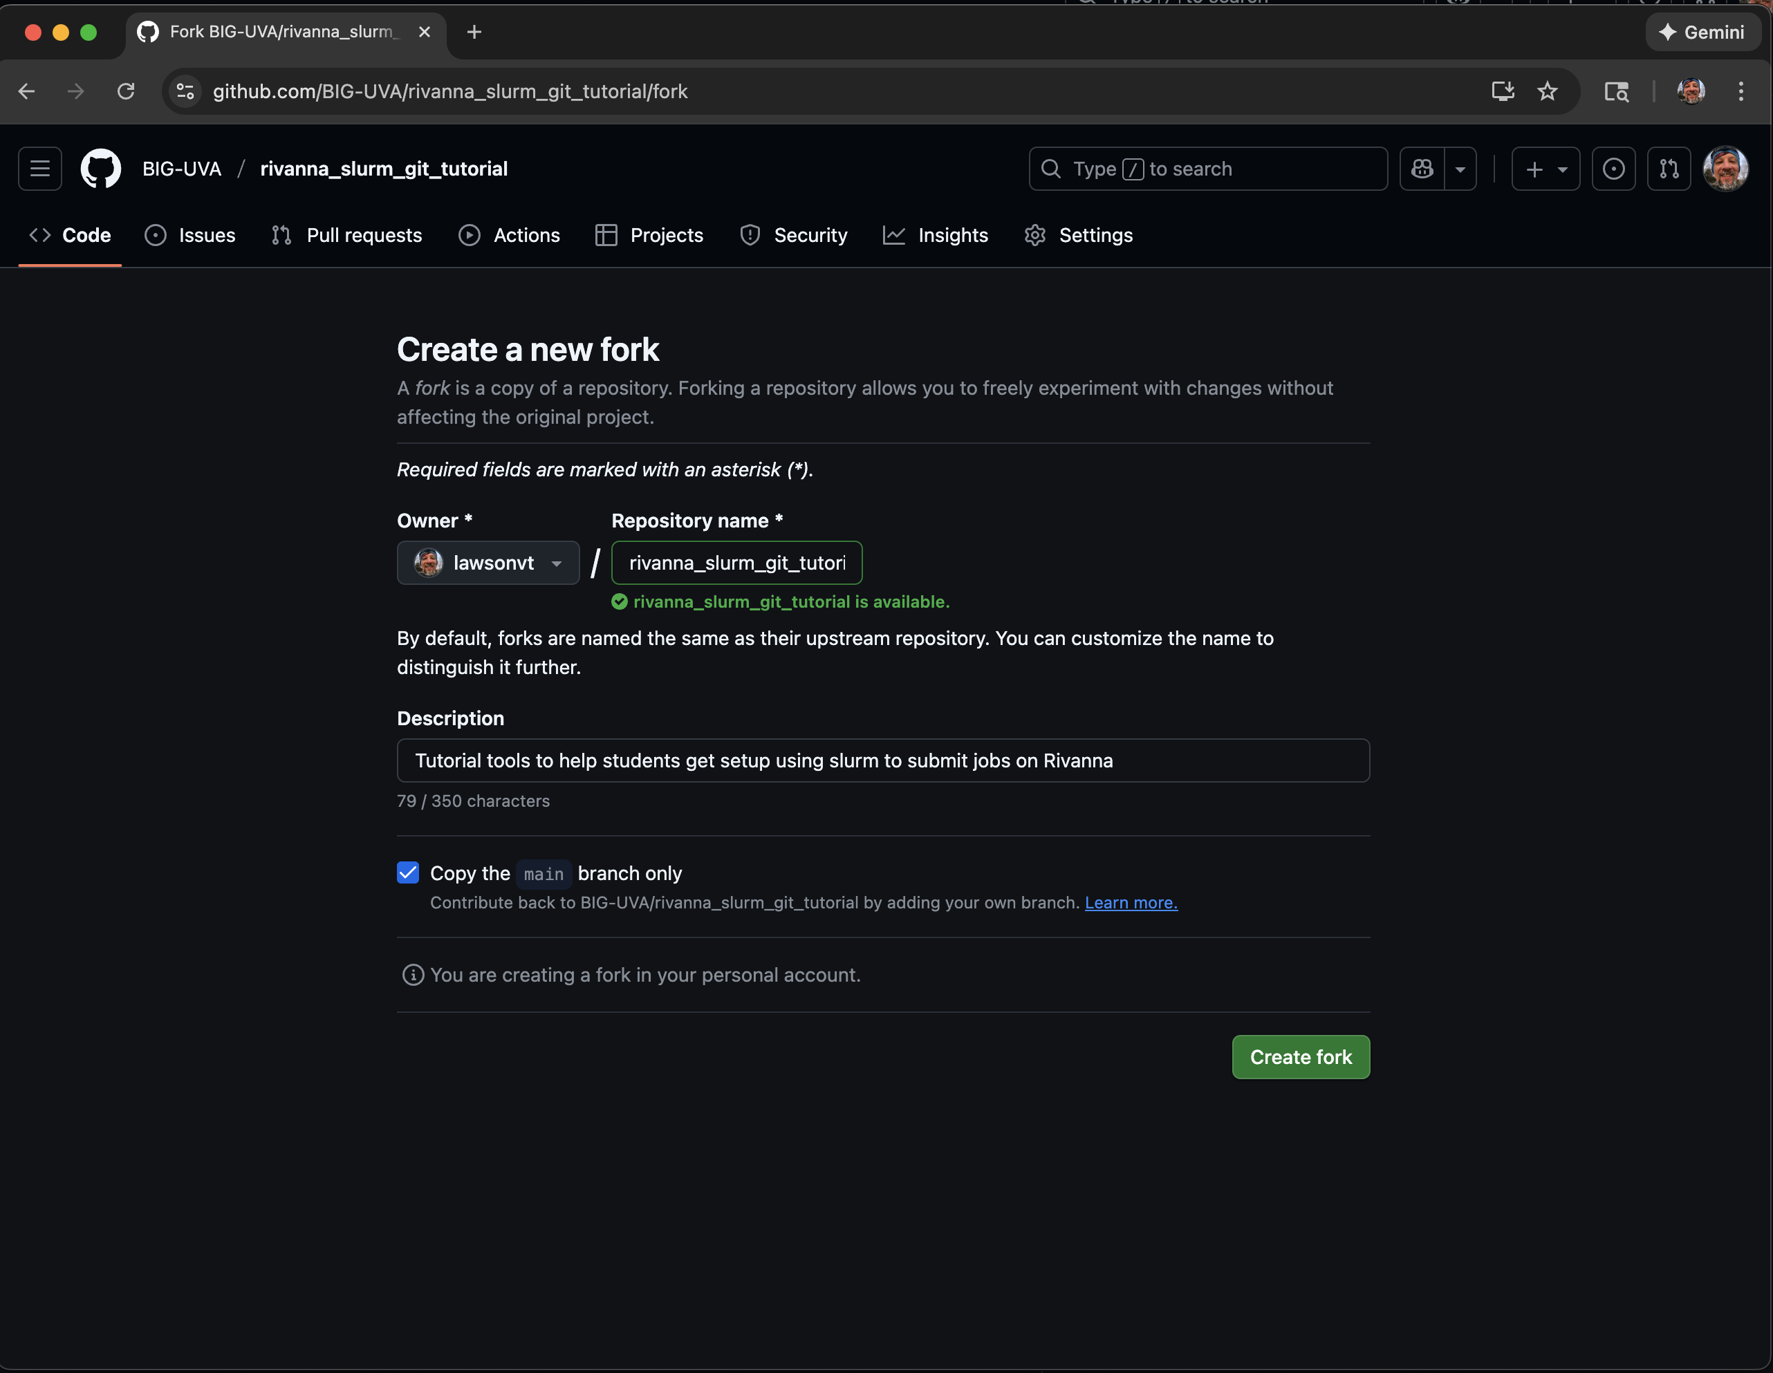
Create the fork in your personal space
Can change the name of the repository
Click here to create the fork

Slide 13
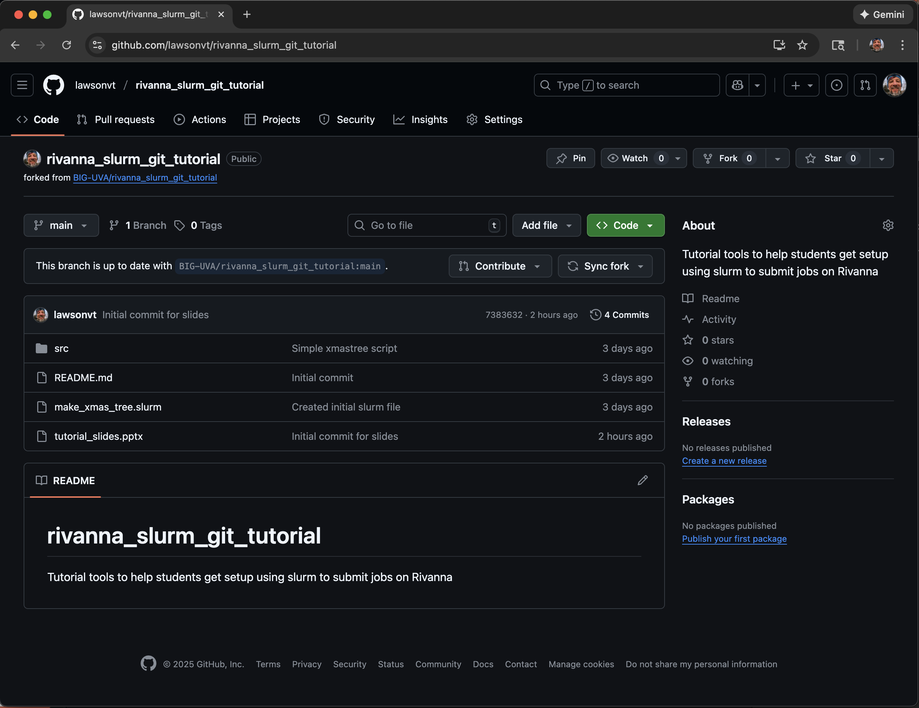
A forked version now exists in your personal repos
Shows the current owner as well as providing a link to the original repo
Otherwise looks the same as the original repo

Slide 14
Creating an SSH key
While you can clone any public Github repo, in order for you to create new commits to the repo, you need to be authenticated
There are many ways to do this, but the easiest is to use SSH-Keys
Open a terminal and create a key using this command
ssh-keygen -t ed25519 -C "your_email@example.com"
Feel free to skip creating a password, otherwise you will need to use it for every commit
Then copy the key to the clipboard
cat ~/.ssh/id_ed25519.pub | pbcopy

Slide 15
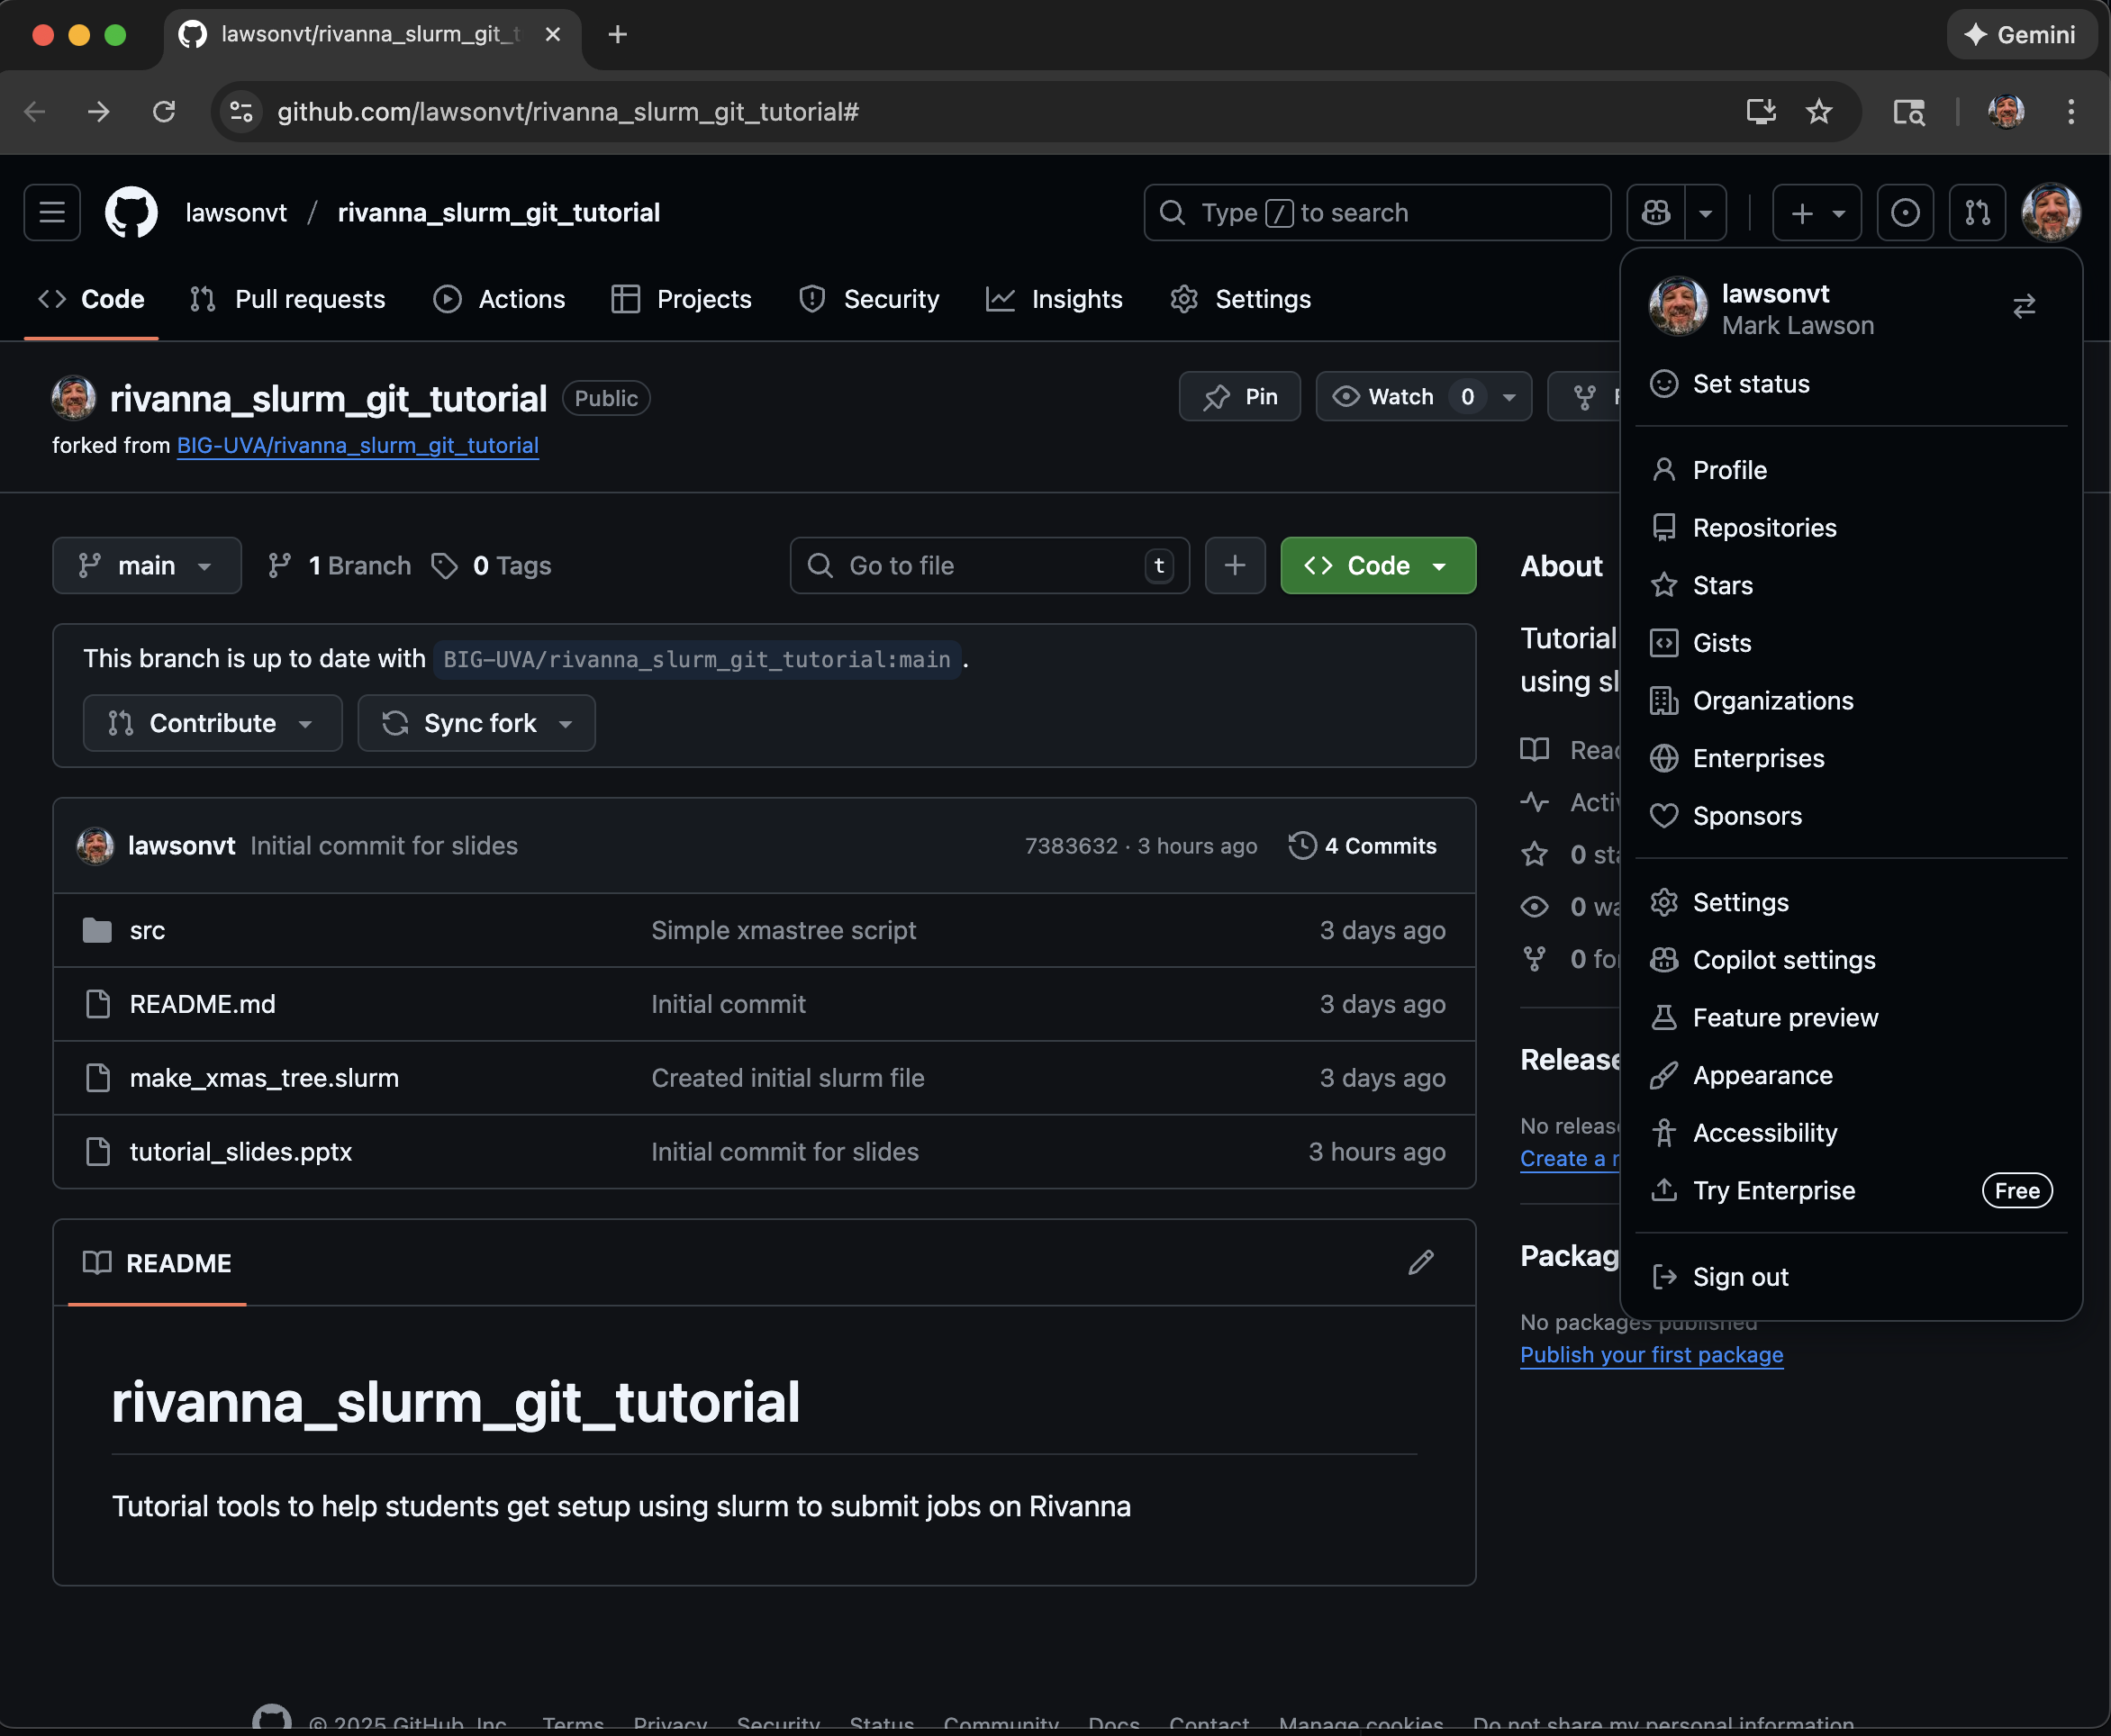
Adding the SSH key to Github

Slide 16
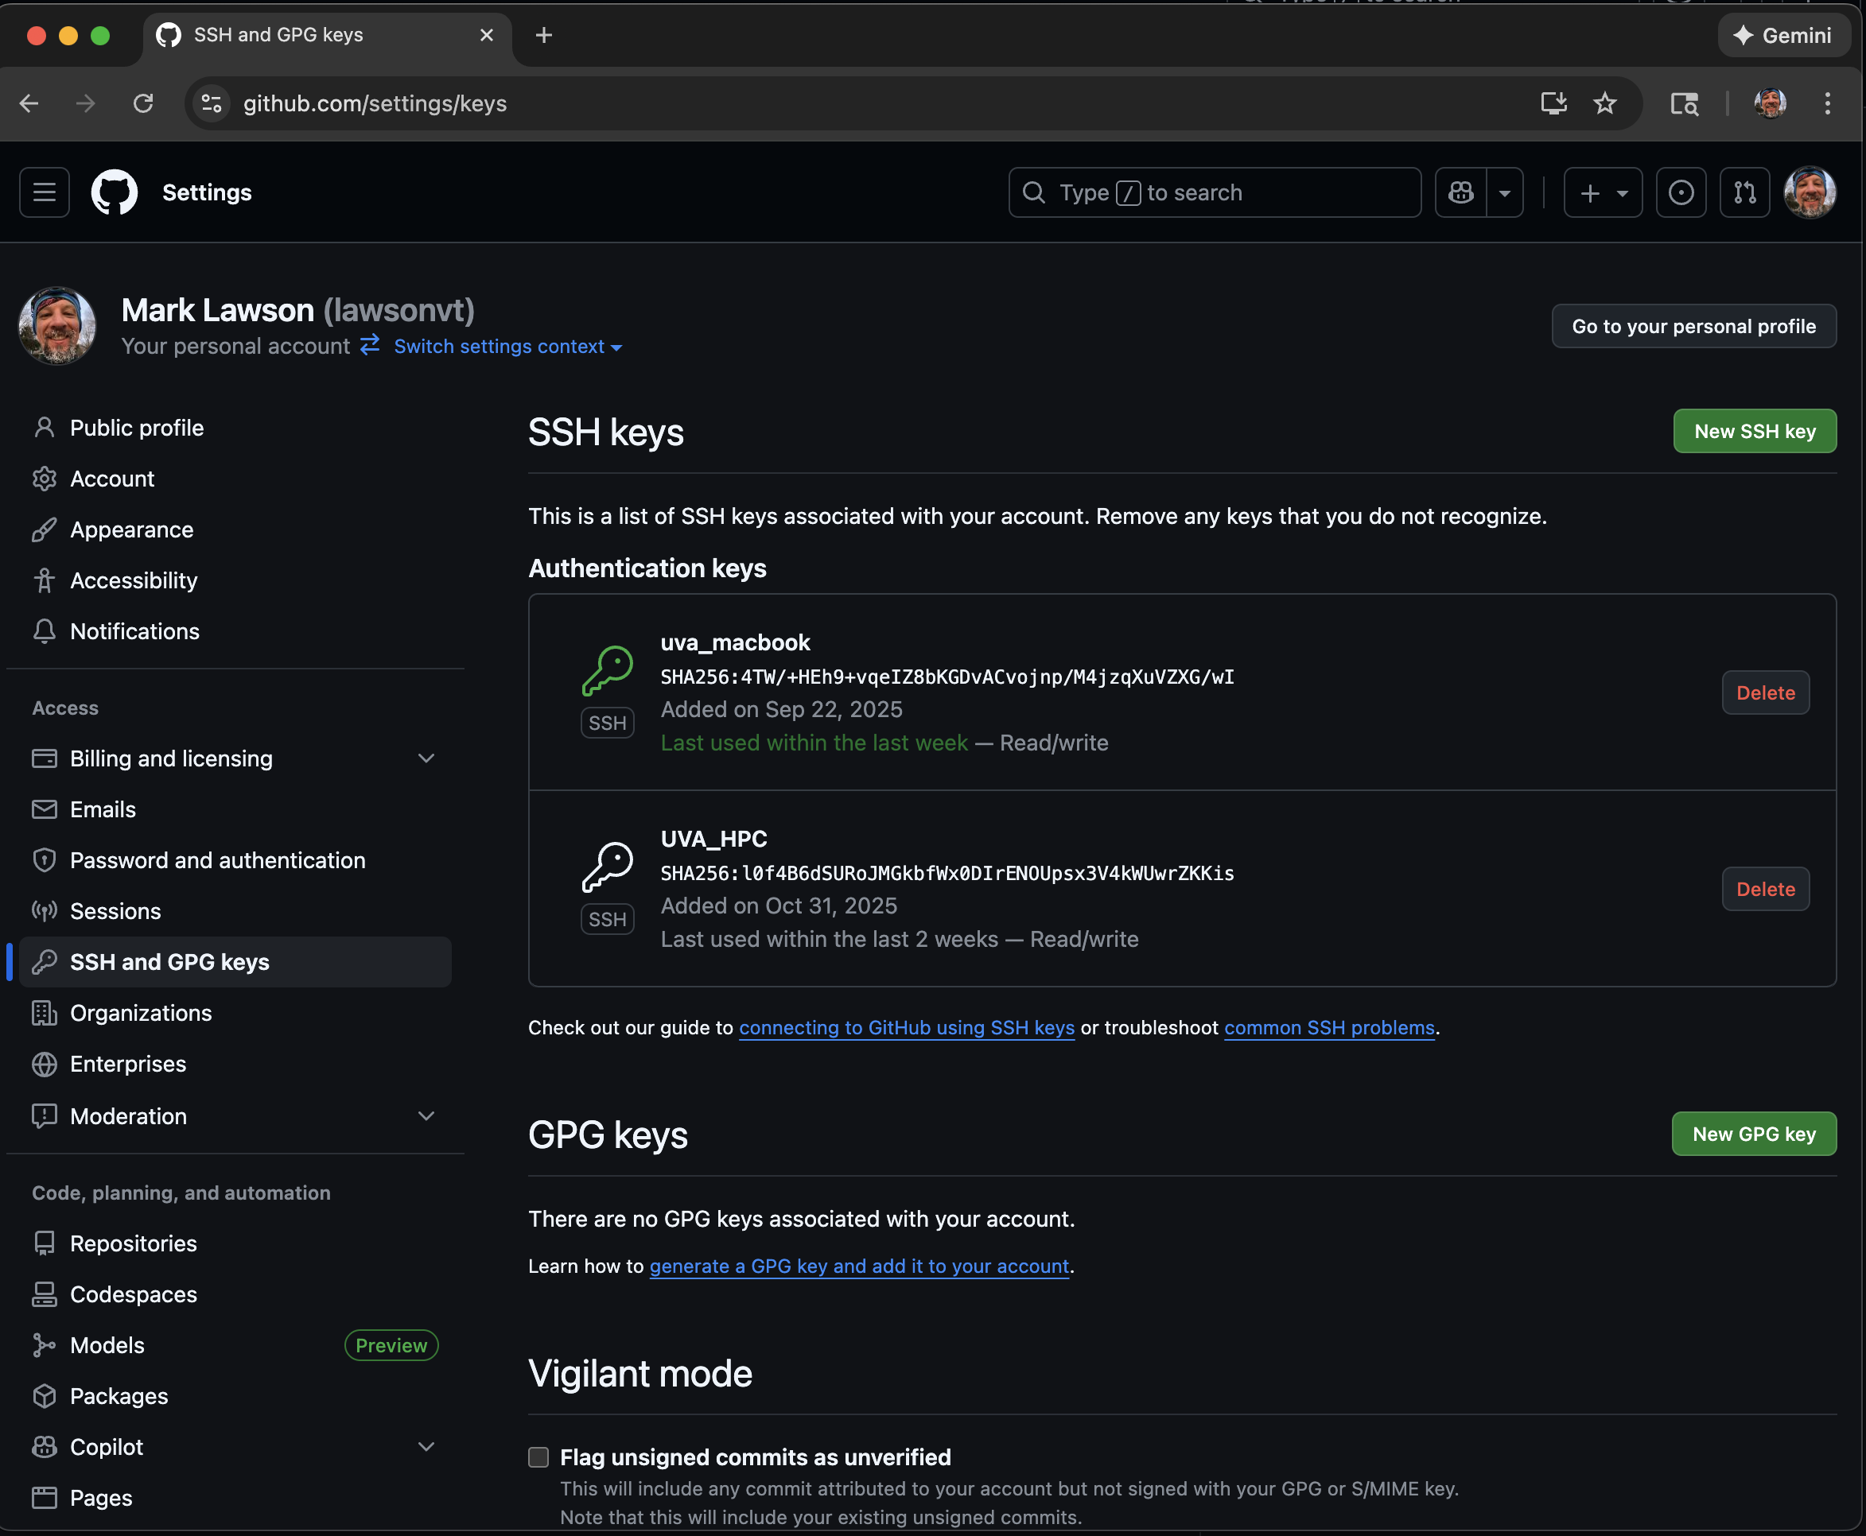
Adding the SSH key to Github

Slide 17
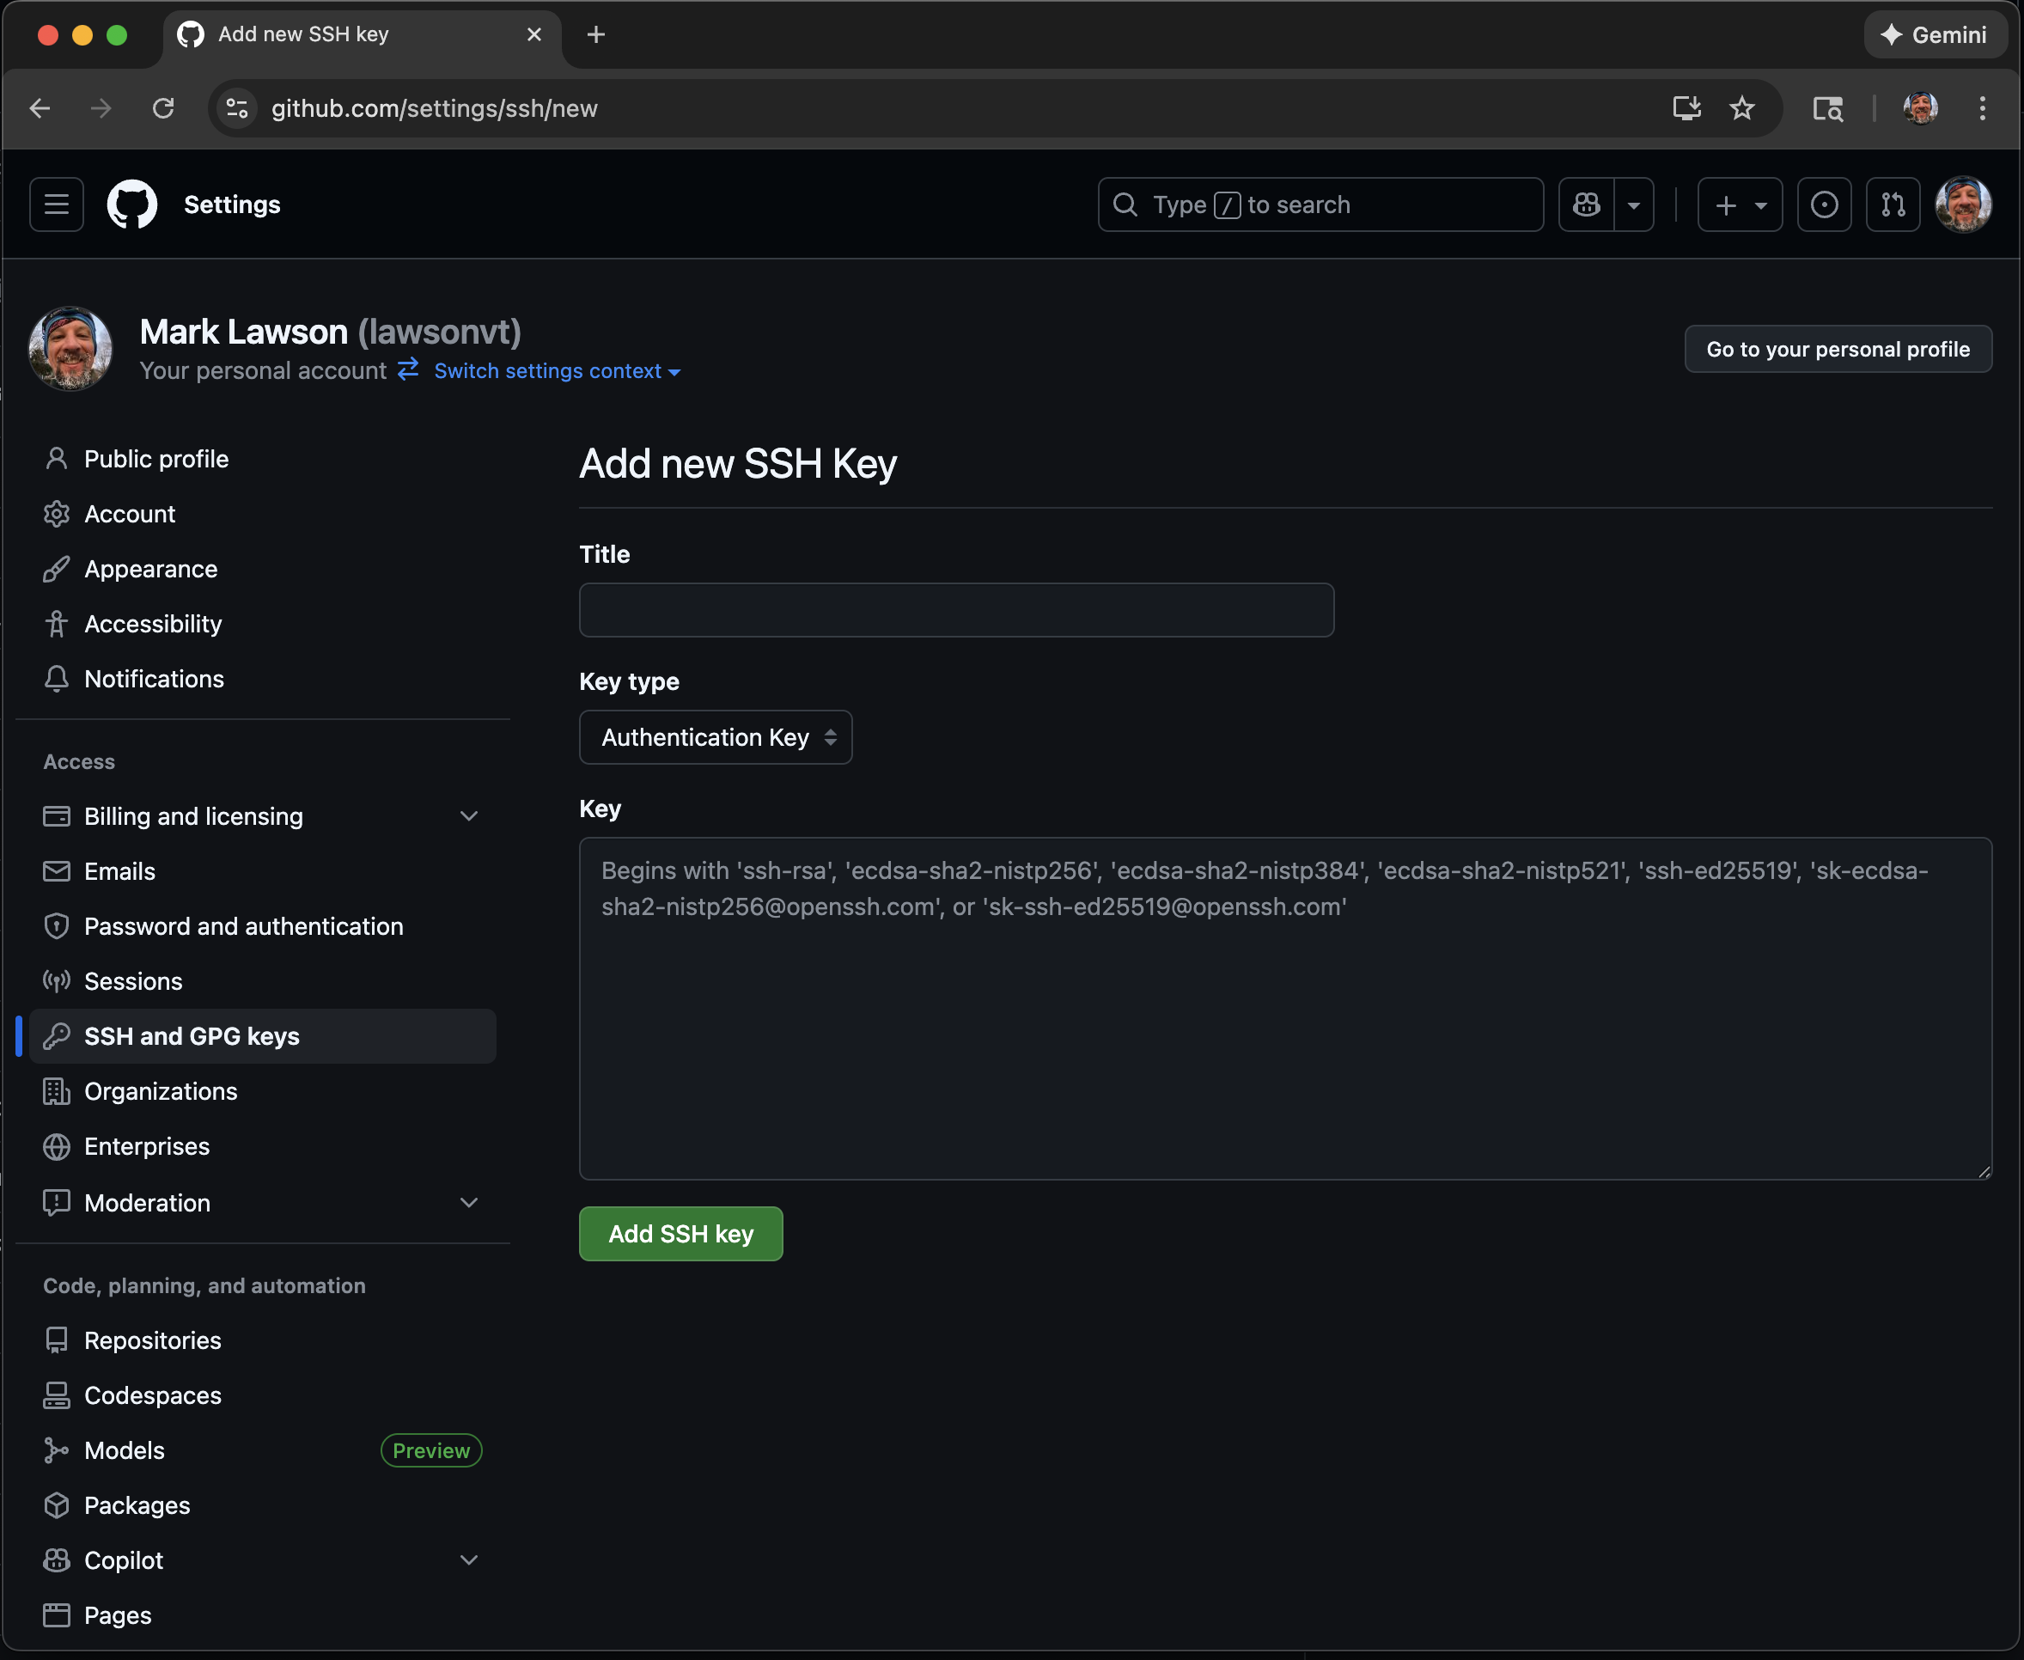
Adding the SSH key to Github

Slide 18
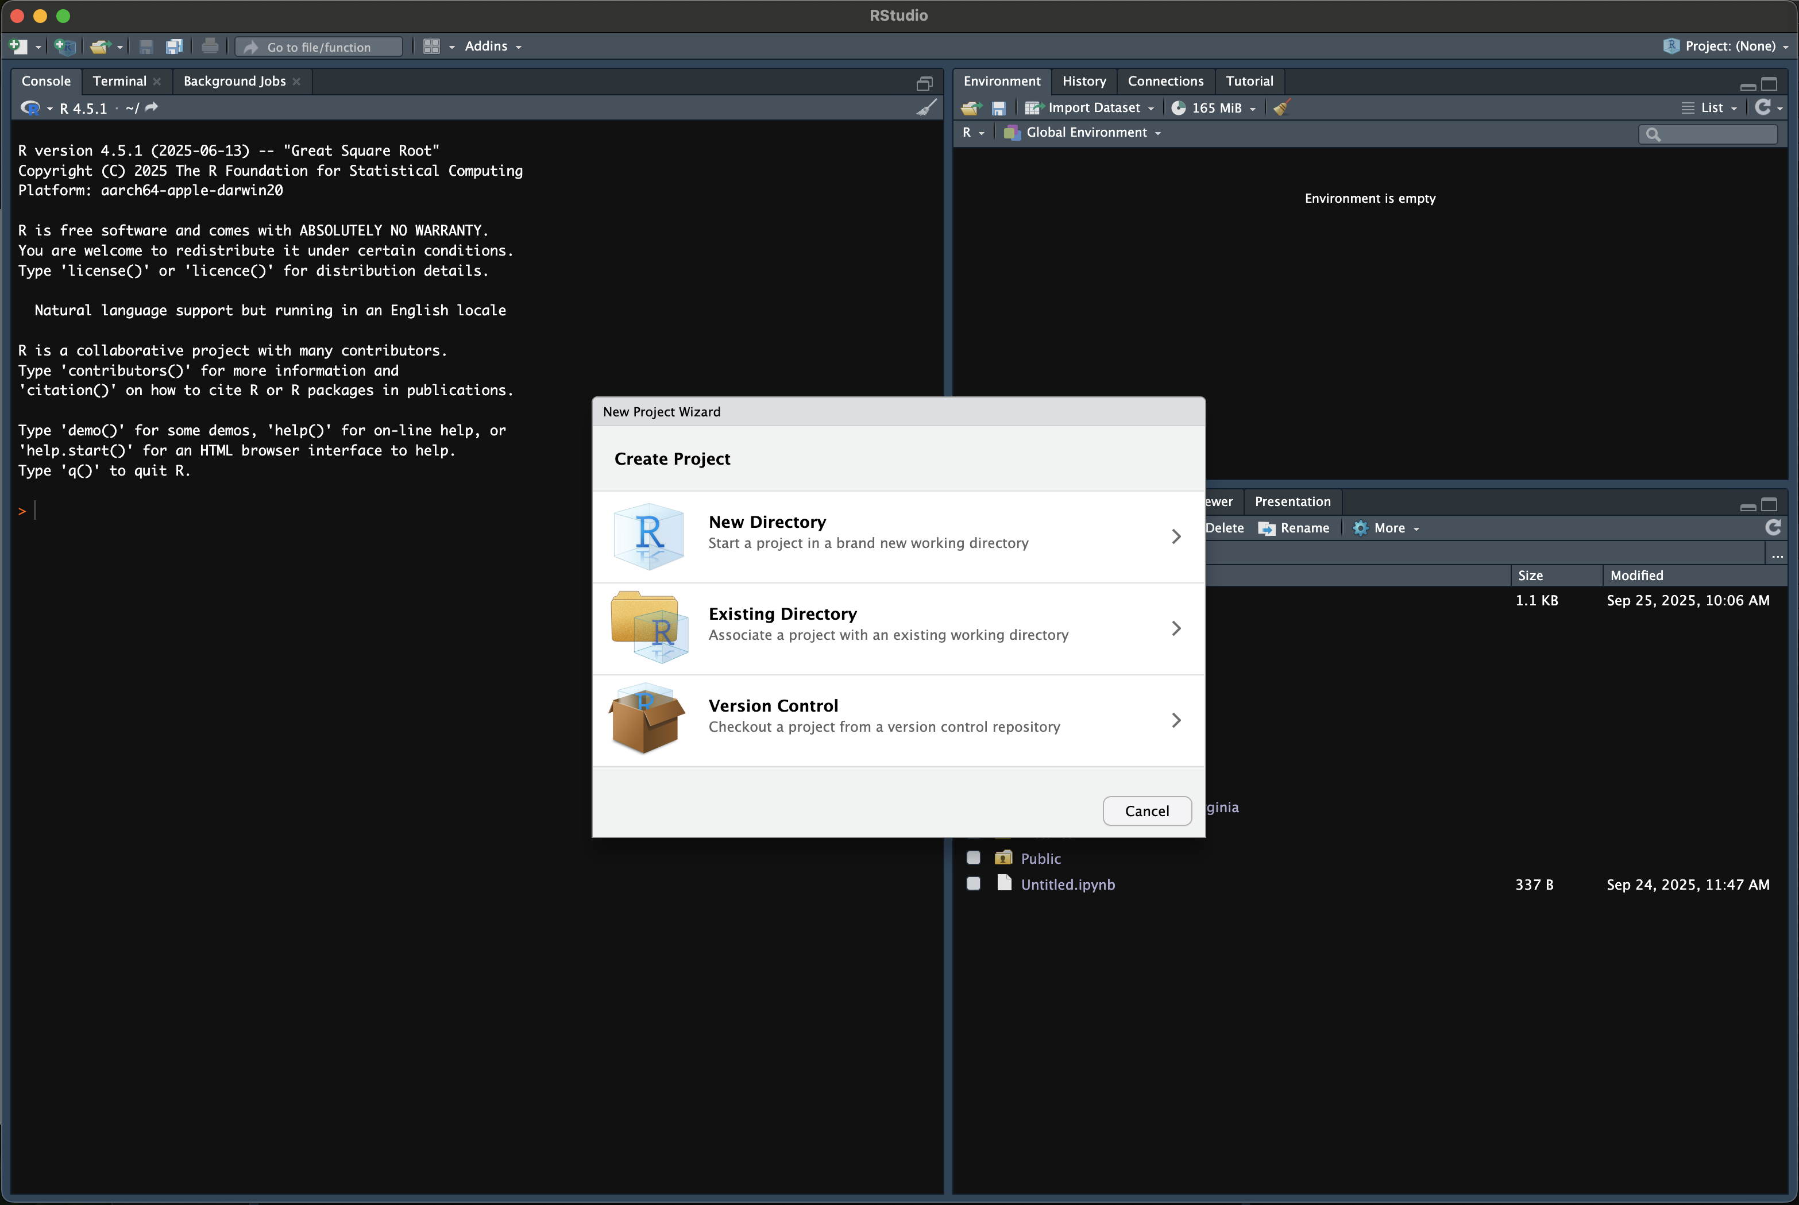
Create a new project in Rstudio

Slide 19
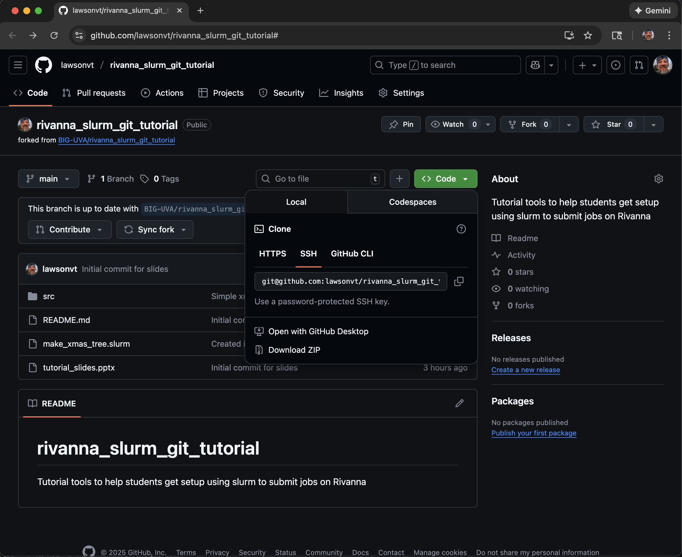
Clone the repo

Slide 20
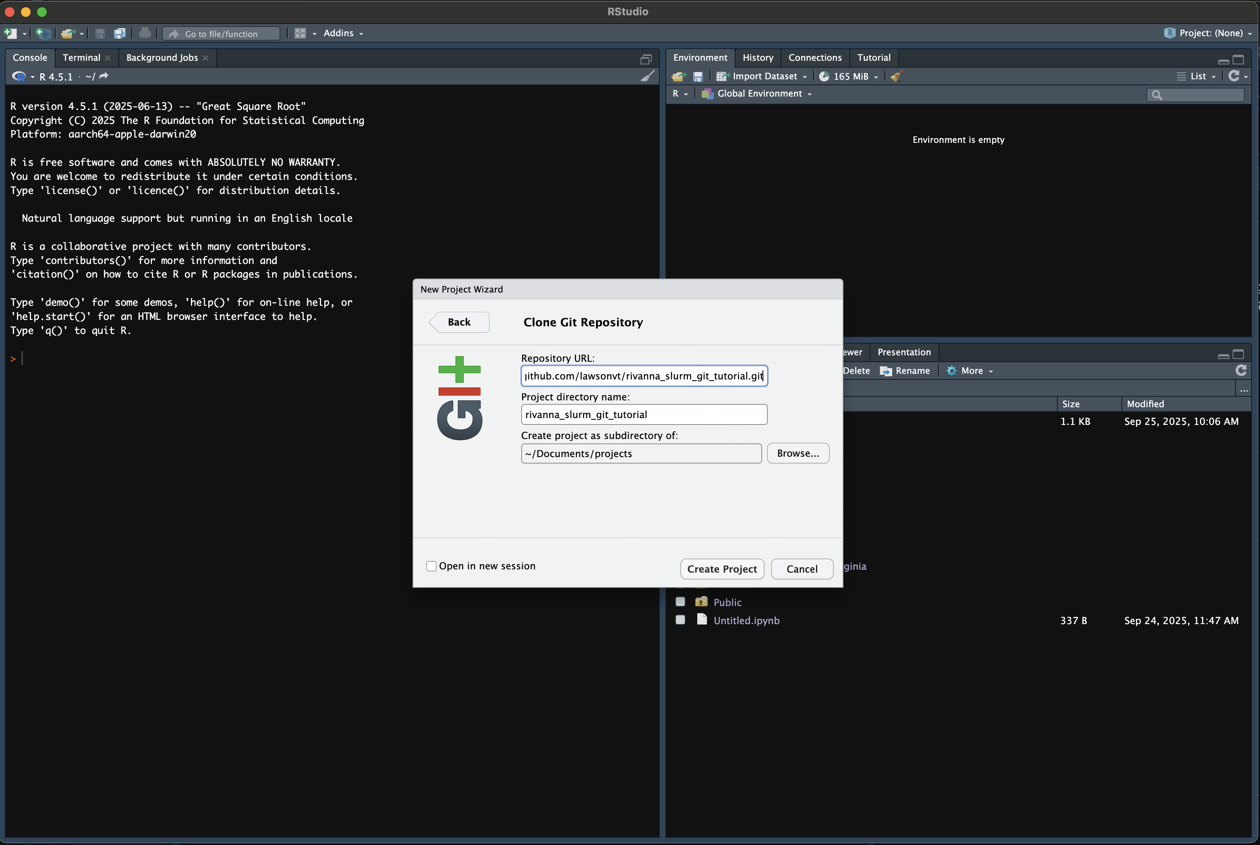
Create a new project in Rstudio

Slide 21
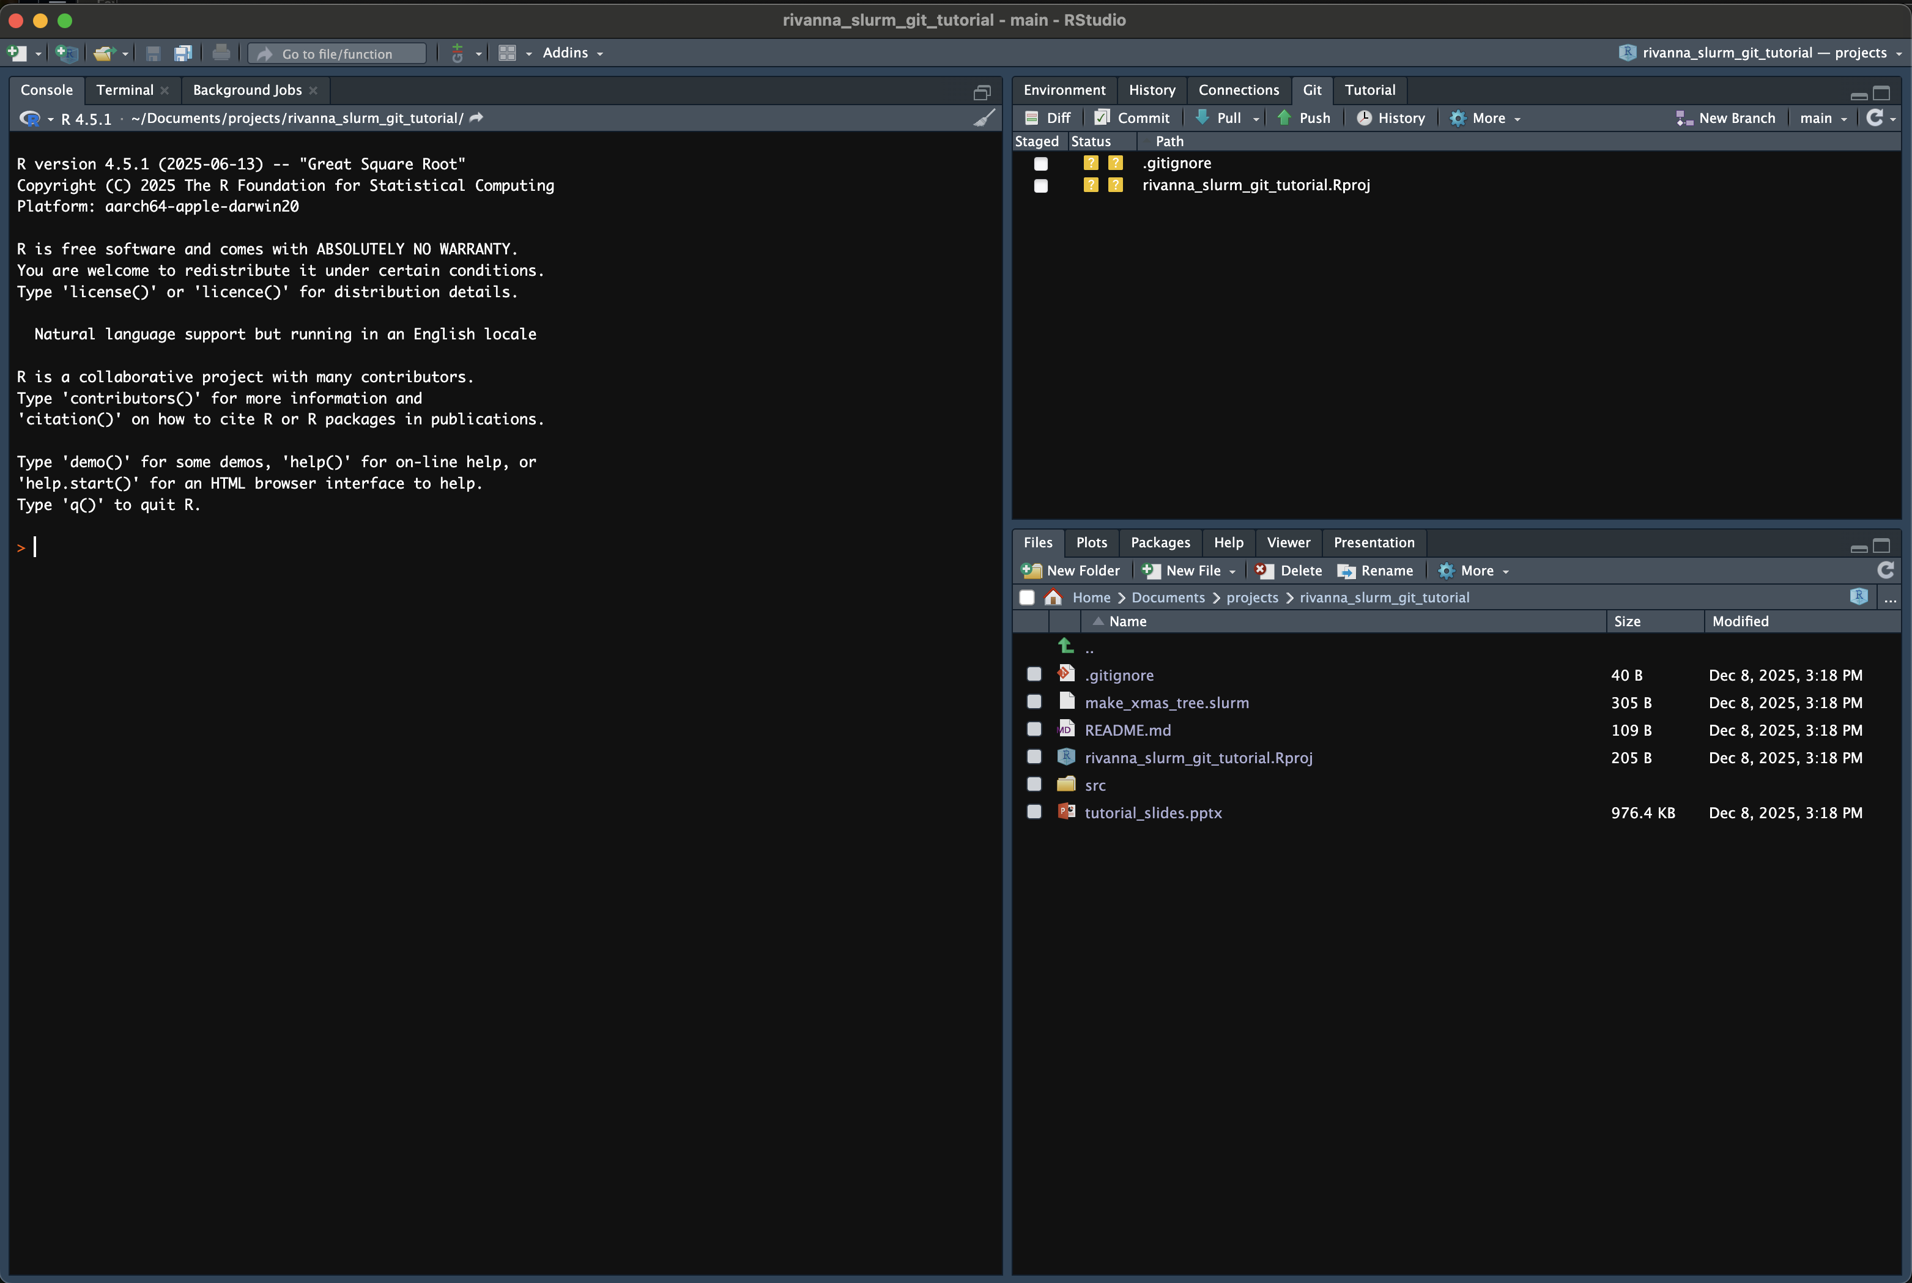
Create a new project in Rstudio

Slide 22
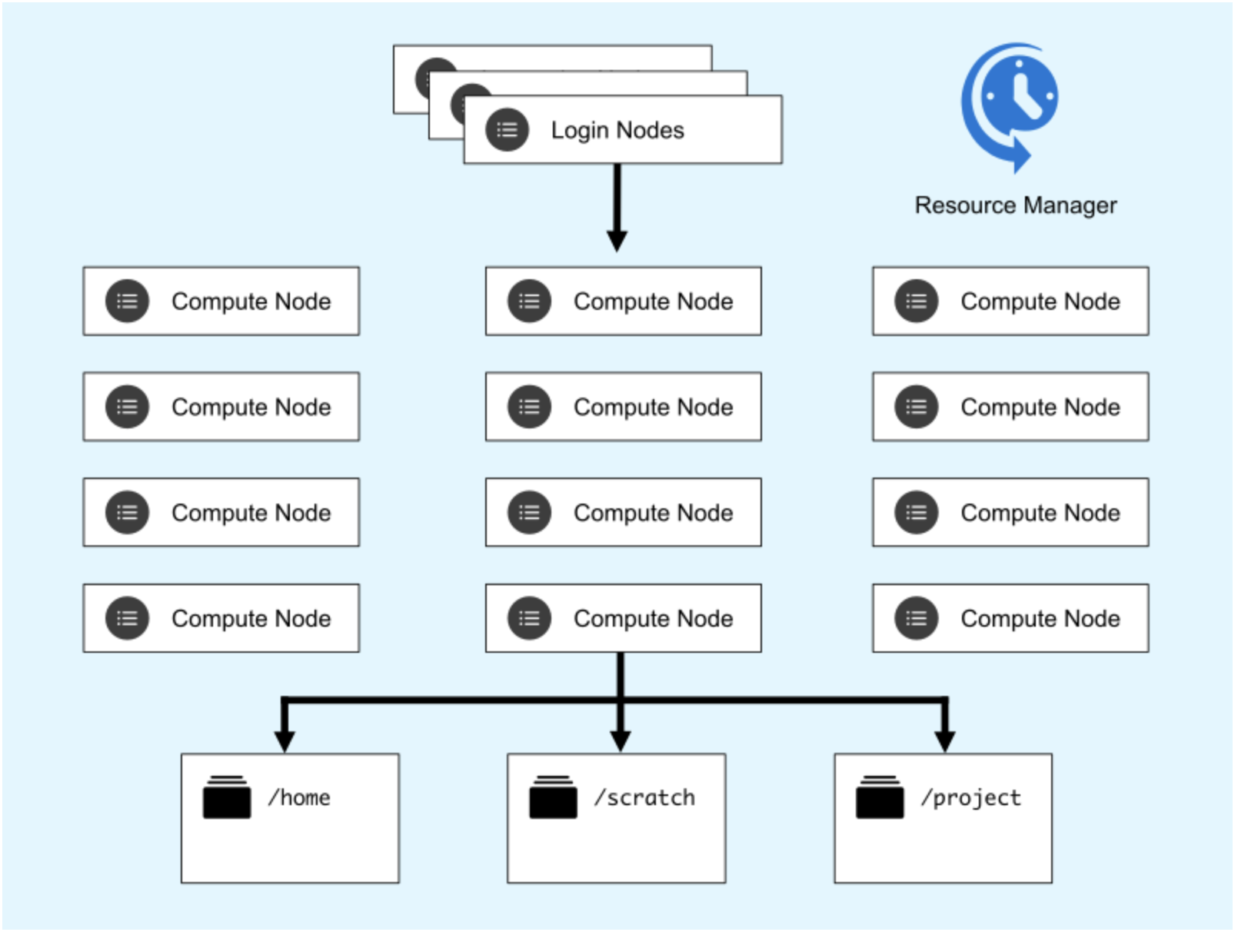
Rivanna – UVA’s High Performance Computing Environment
UVA Resarch Computing provides access to various HPC environments, of which Rivanna is one
Basically, this gives the researcher the ability to run jobs that would be beyond their laptop
In terms of memory, processors, computing time
To do this, a researcher logs into Rivanna and submits jobs to the cluster
The next parts will go over how this works …

Slide 23
Unix – under the hood of what you are using
Designed as one of the first multi-user operating systems, it is underneath most operating systems in-use today
Linux, Android, iOS/OSX are all Unix-based systems
Windows is NOT
It is a commonly used interface for cloud computing, so some basic knowledge about how it works is very worthwhile to learn
The Rivanna login nodes use Rocky Linux but the basic commands covered here will work for any version of Unix

Slide 24
Simple Unix commands
pwd
Lists your current location or present working directory
ls
Lists the contents of the directory
ls –lh
List the contents in a list format with human readable file sizes
cd <directory>
Change to the given directory
cd ..
Exit the current directory; go one level up
less <file>
Read the given file in the terminal
cat <file>
Have contents of file returned to the command line
ssh <user_id>@<ip_address>
Use secure shell to connect to a remote computer
mkdir <new_directory>
Make a new directory
cp <file> <new_file>
Make a copy of the given file to with new given file name
cp -r <folder> <new_folder>
Make a copy of the given folder to the new given folder name (using recursion)
rm <file>
Delete (or remove) the given file
warning: this is permanent!
rm –r <folder>
Delete the given folder (using recursion)
exit
Exit the session (for instance disconnect ssh)

Slide 25
Tutorial Part 2
Login to Rivanna
git clone the repository into Rivanna
Move into the cloned repo
Make a change to the code on Rstudio
Commit and push change
git pull the change

Slide 26
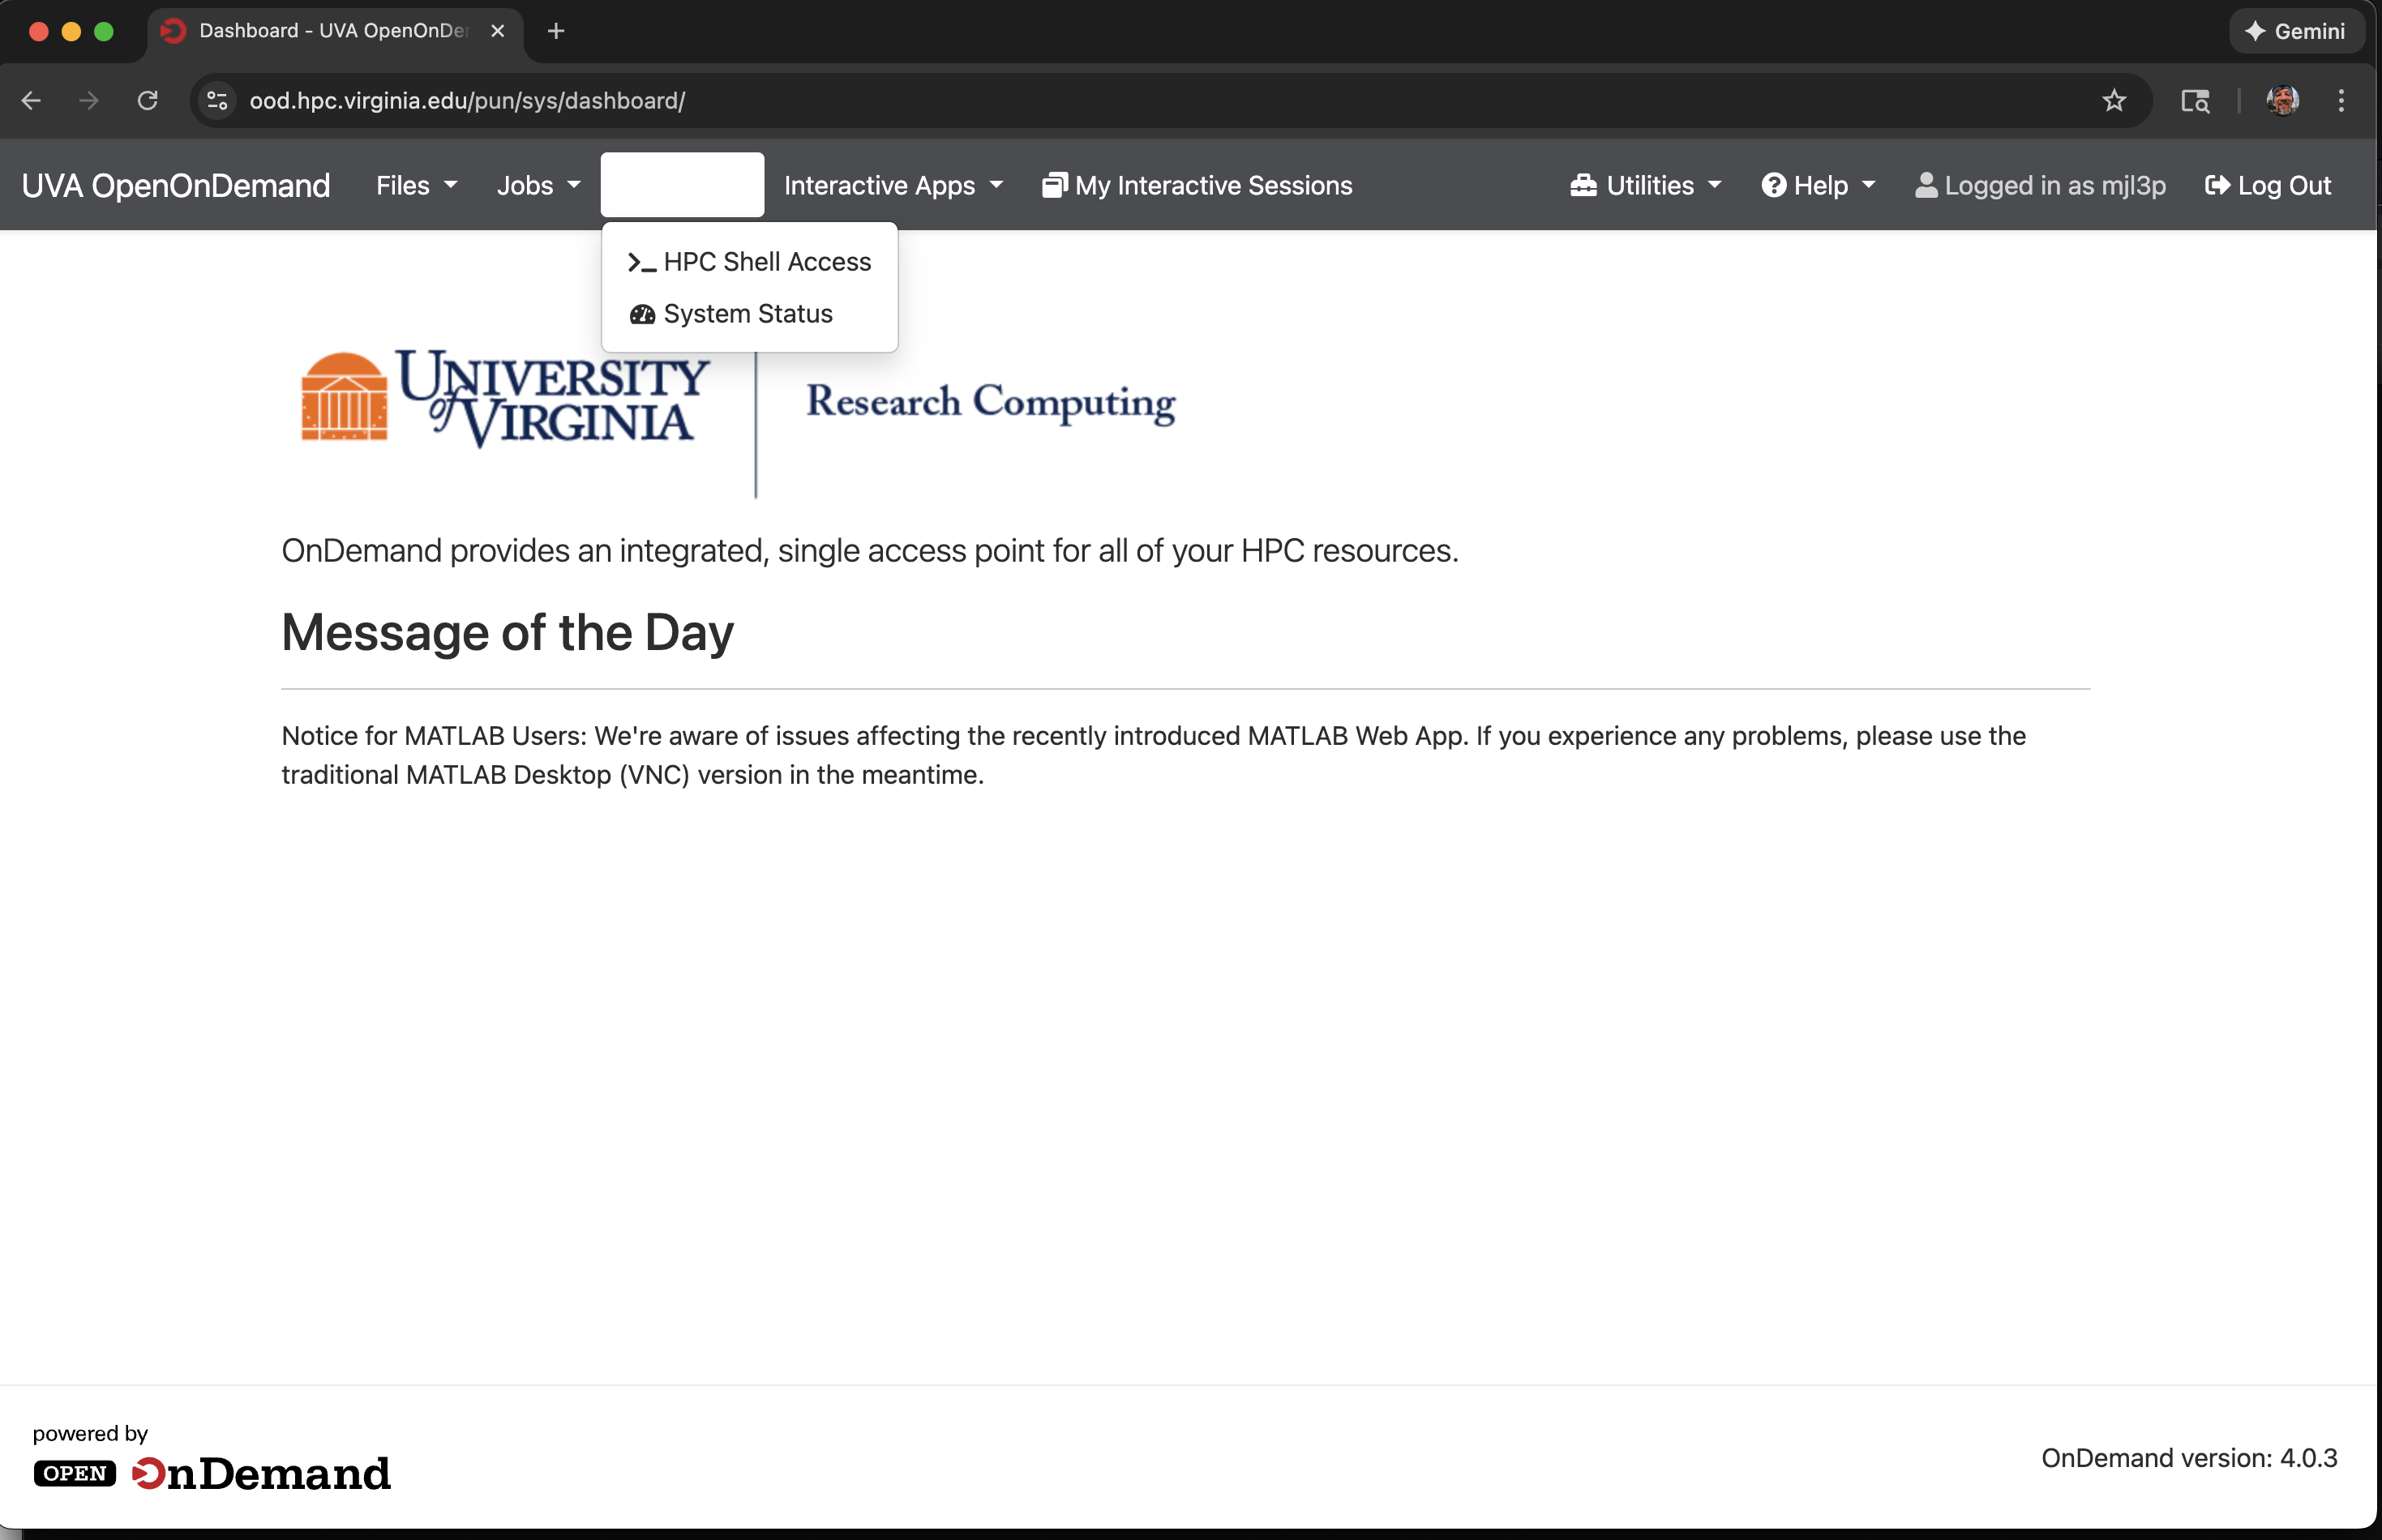
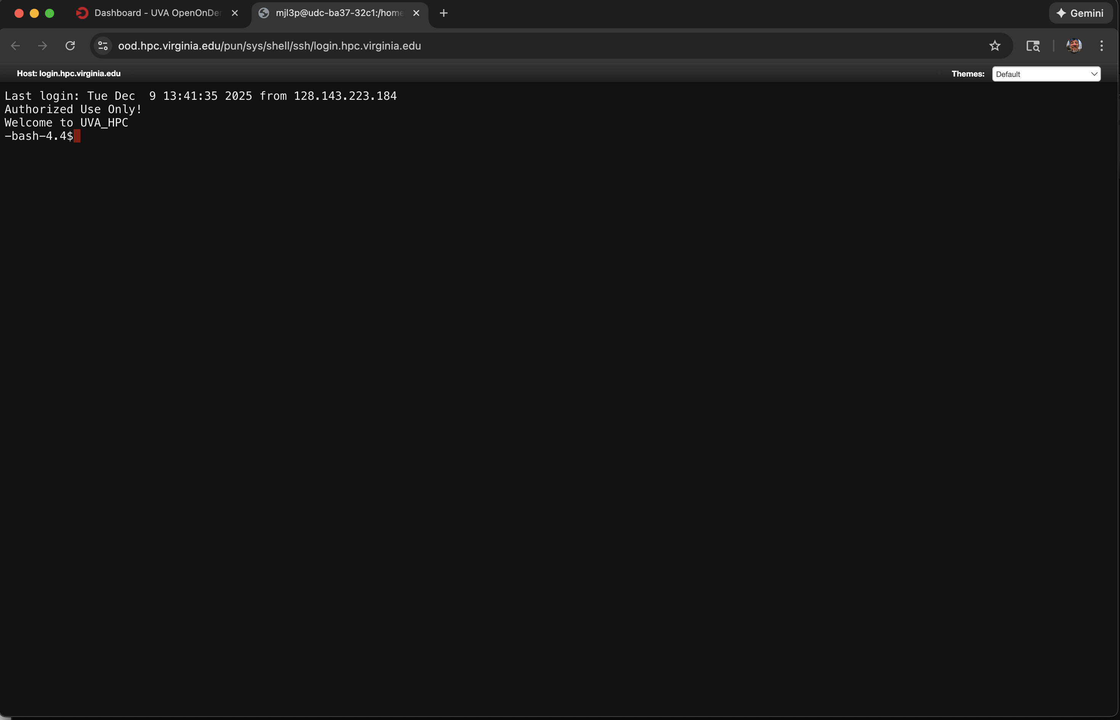
Logging into Rivanna – Option 1
Open On Demand https://ood.hpc.virginia.edu/
Select “Clusters”
Select “HPC Shell Access”

Slide 27
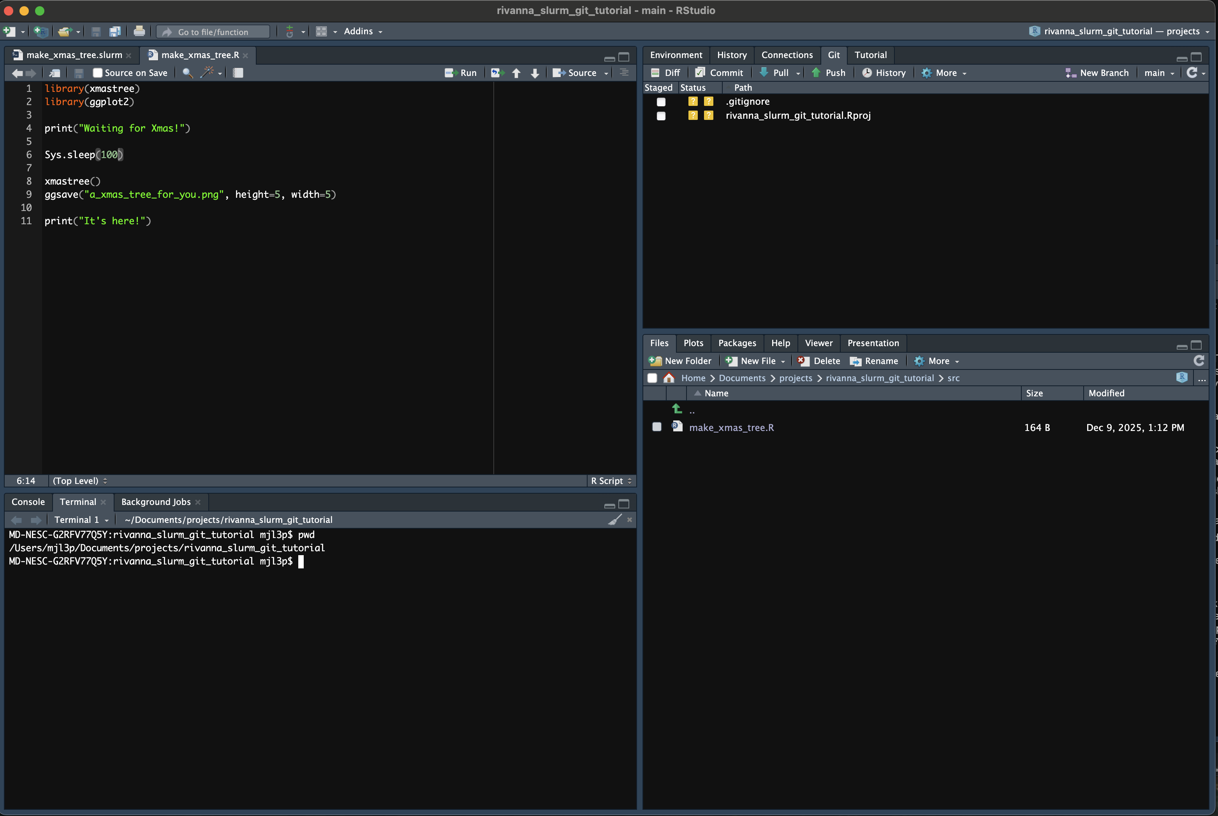
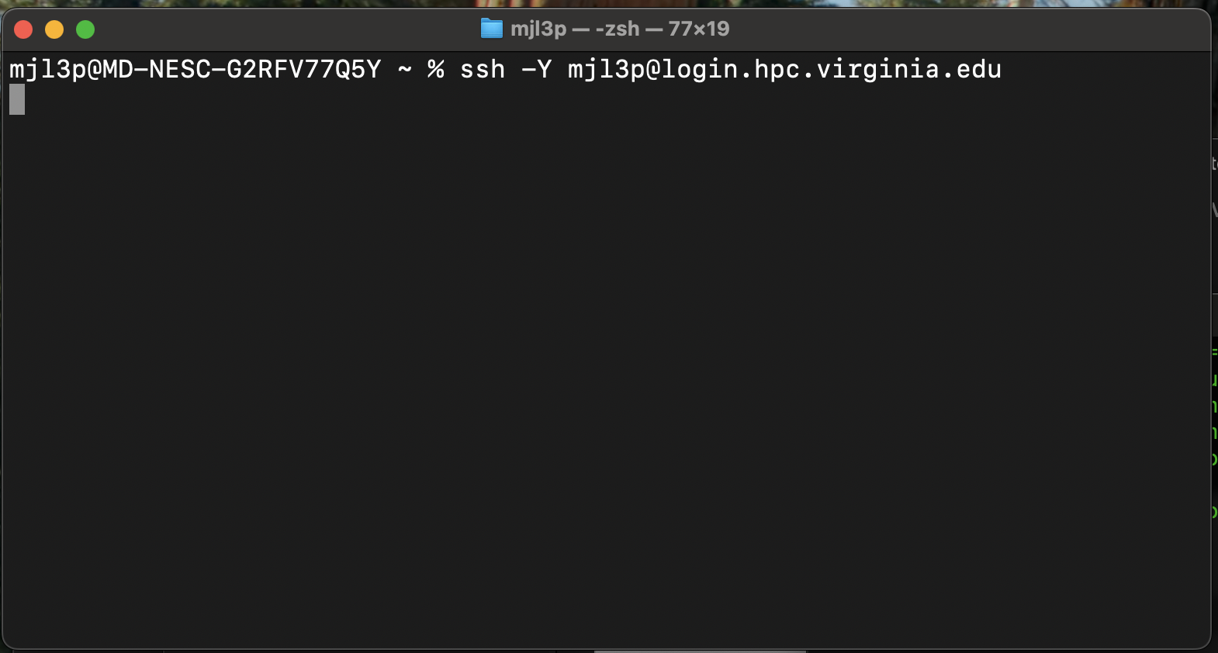
Logging into Rivanna – Option 2
Use secure shell (SSH):
ssh –Y <your_user_id>@login.hpc.virginia.edu

Slide 28
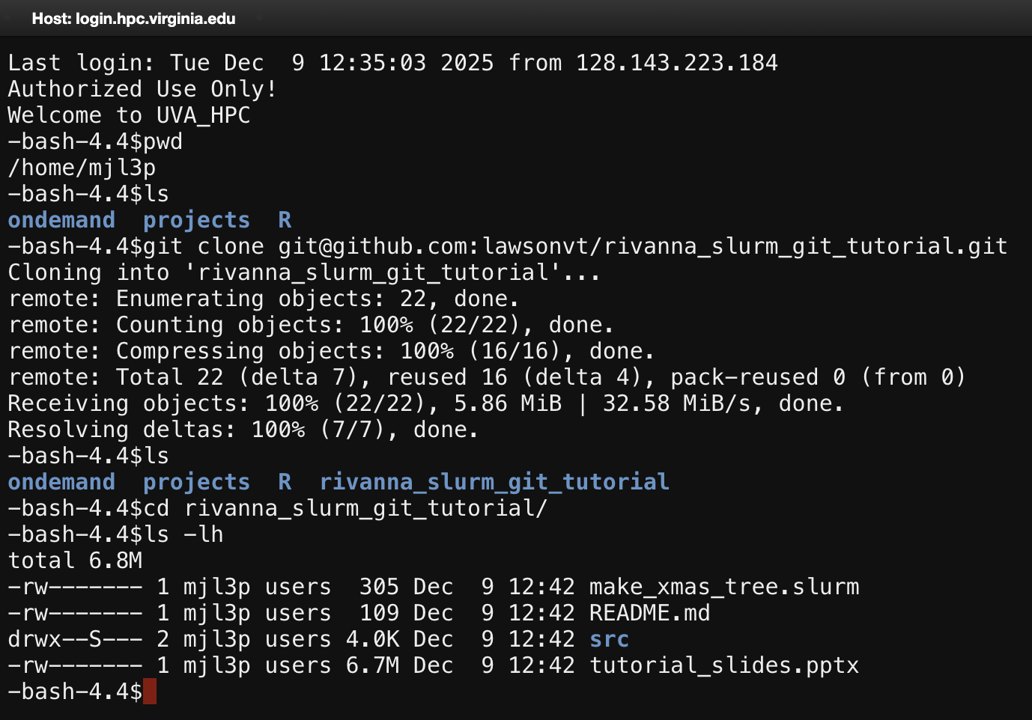
Unix Command Line

Slide 29
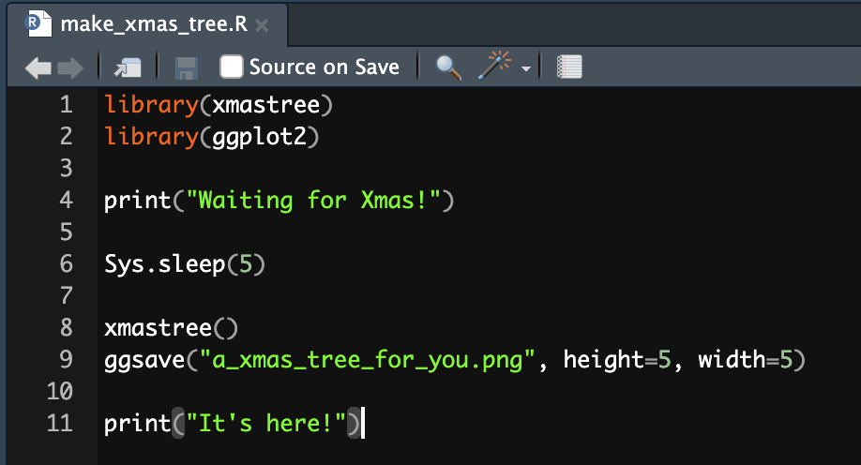
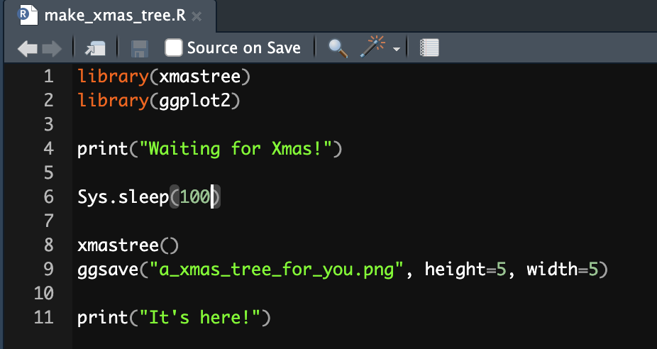
Let’s make a change!

Slide 30
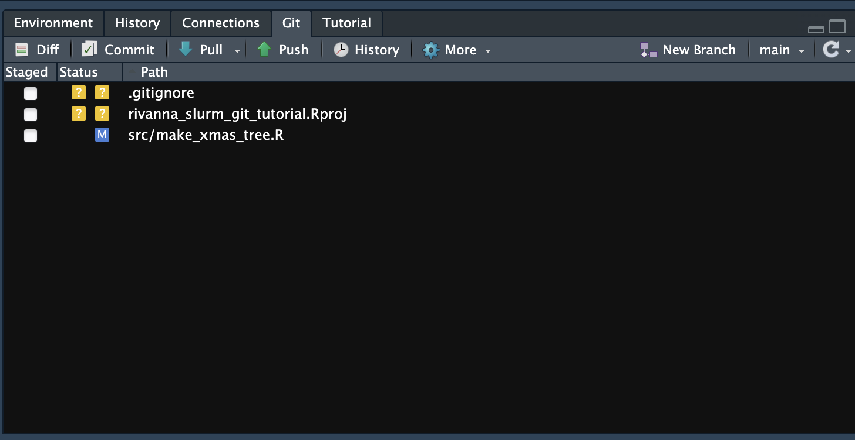
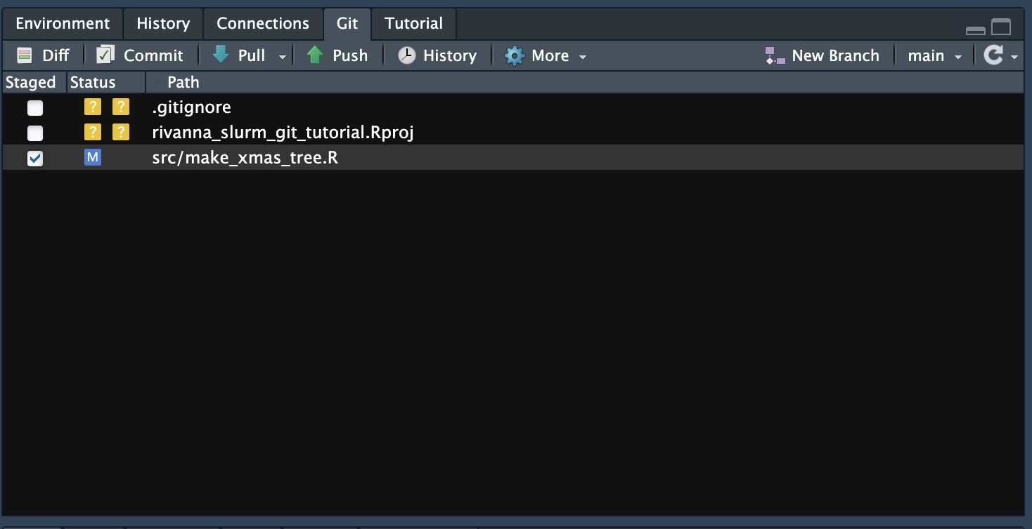
Start the commit!

Slide 31
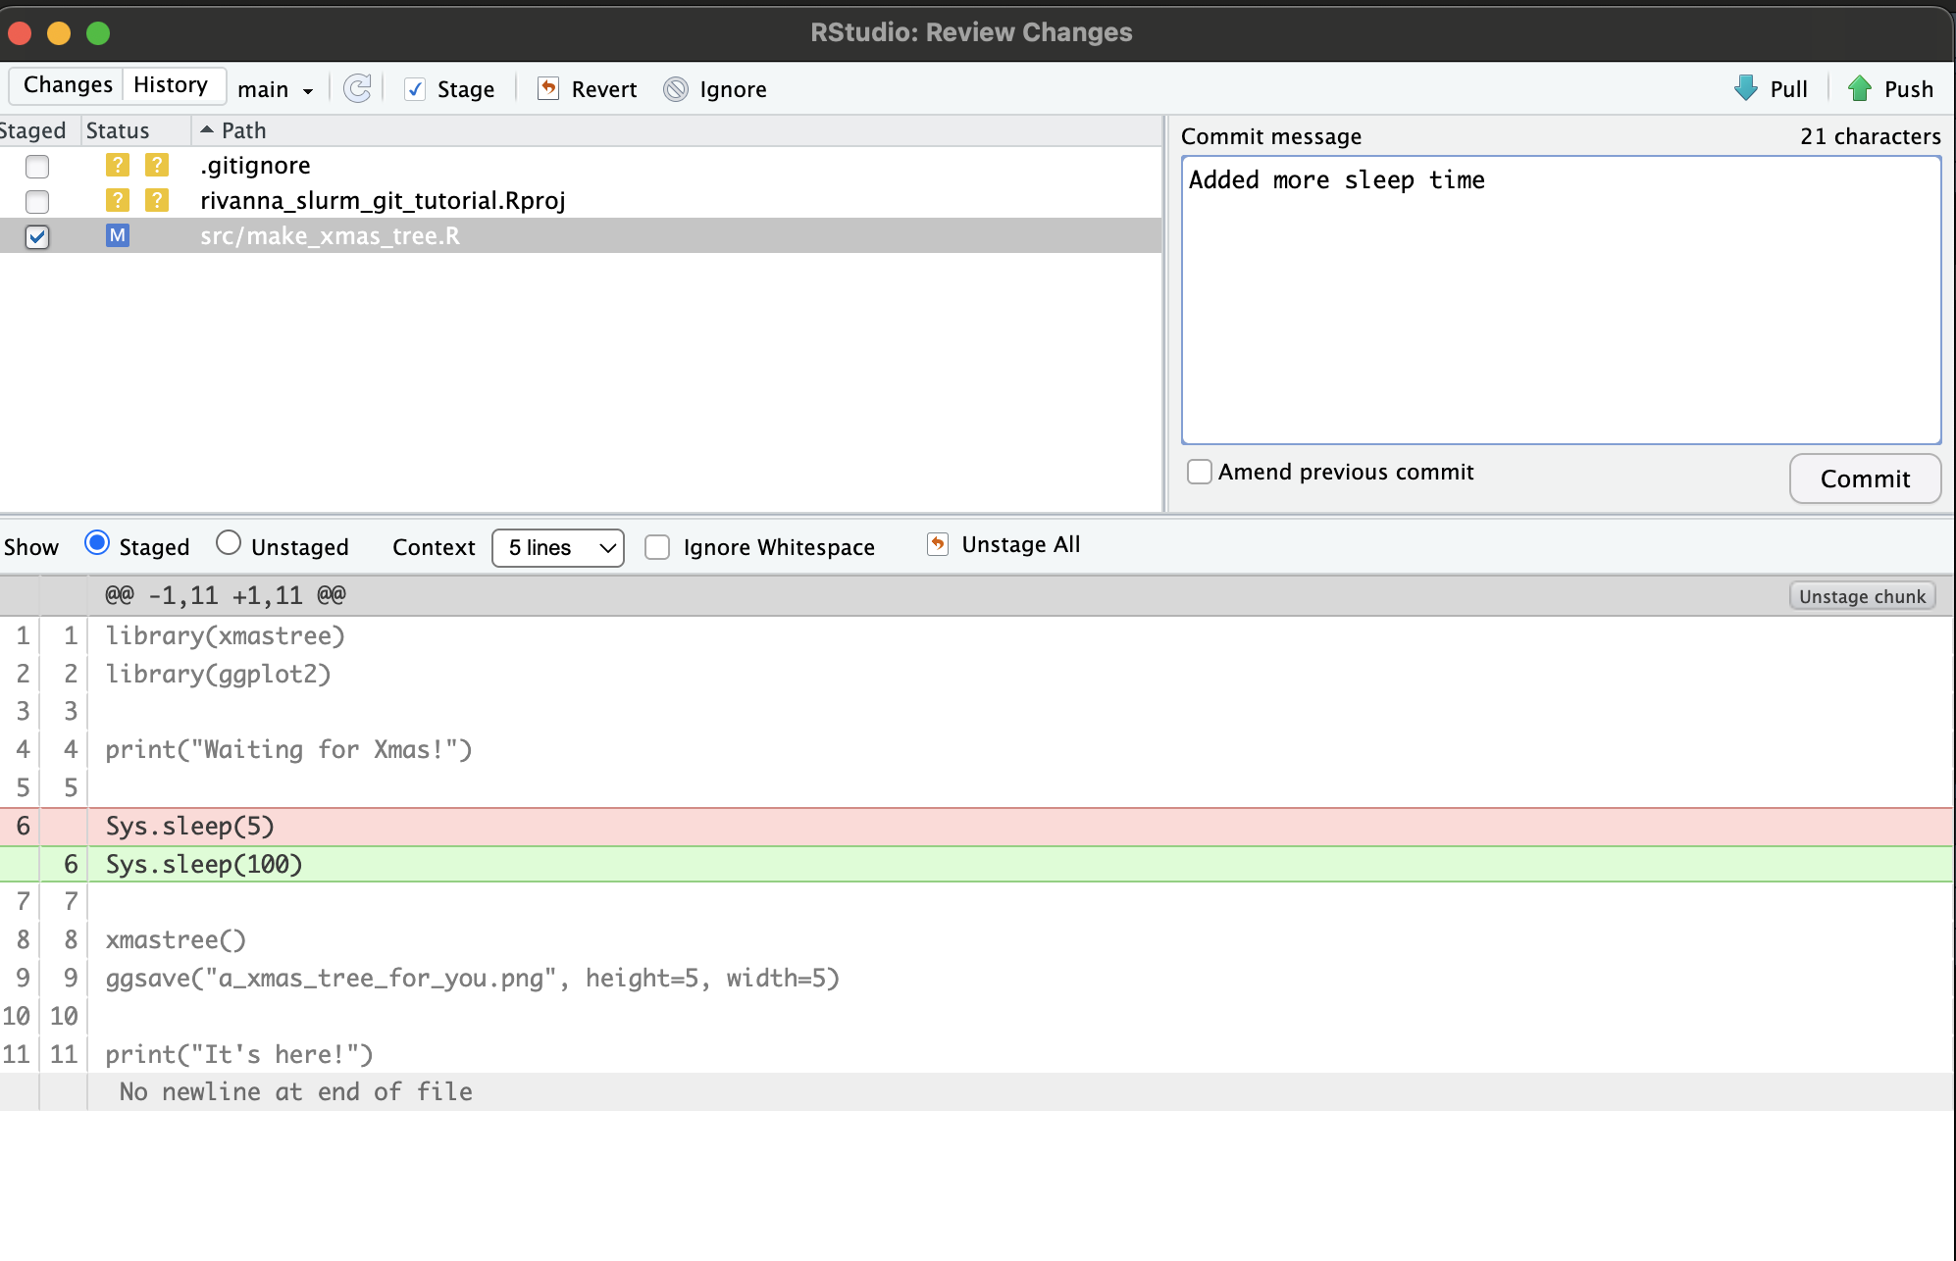
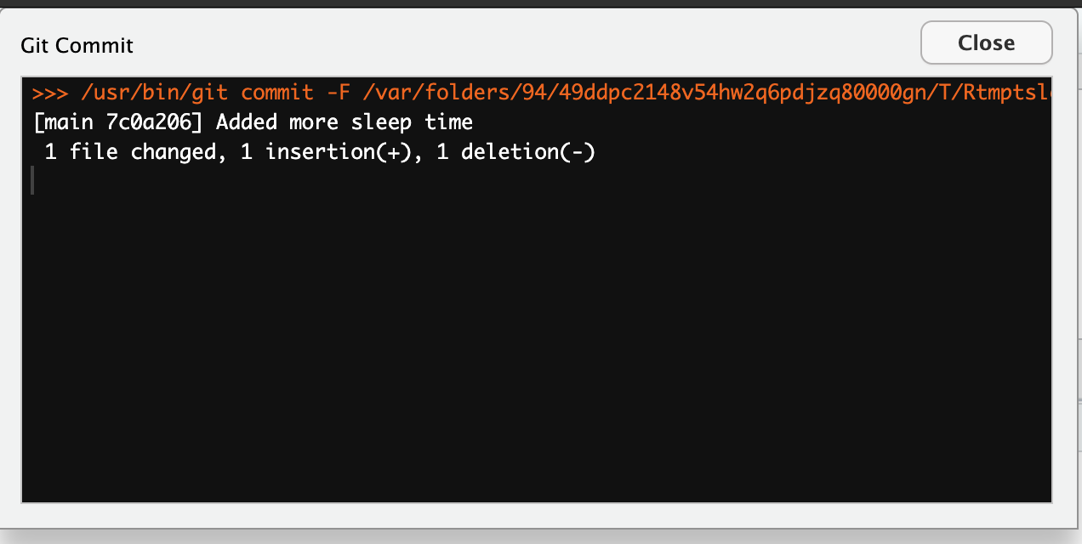
Commit the change!

Slide 32
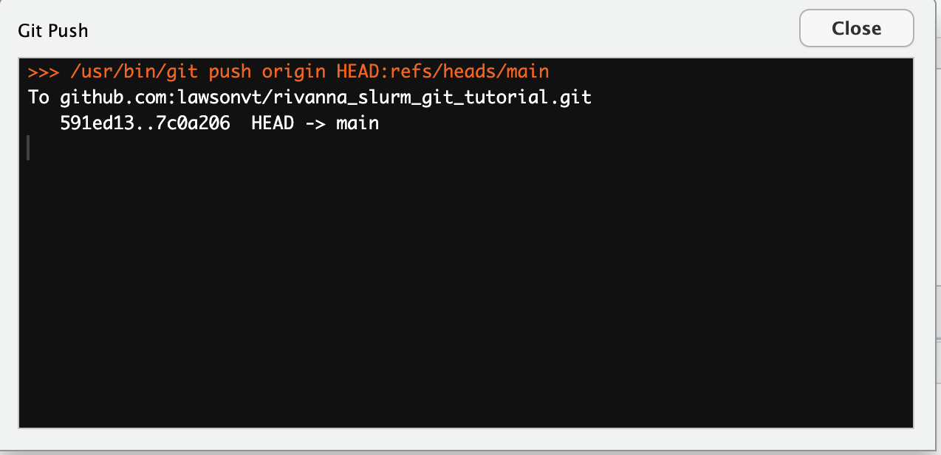
Push the change!

Slide 33
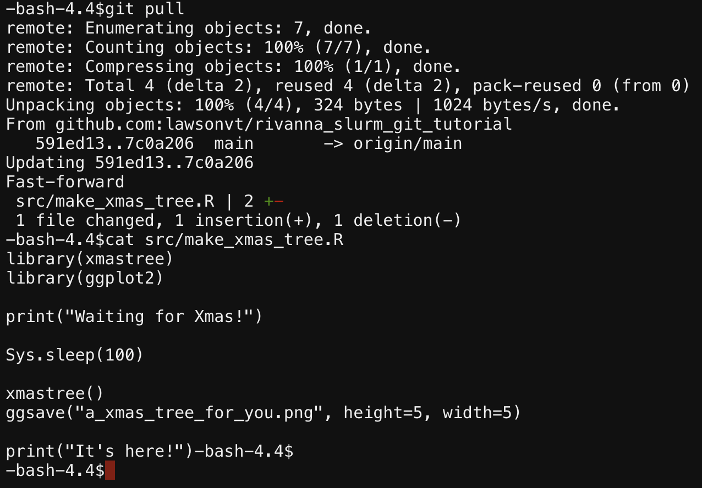
Pull the change (on Rivanna)!

Slide 34
Tutorial Part 3
Submit job with slurm
Job had error, read file to see why
Load R and install missing package
Submit job again
Monitor job in the queue
Check results

Slide 35
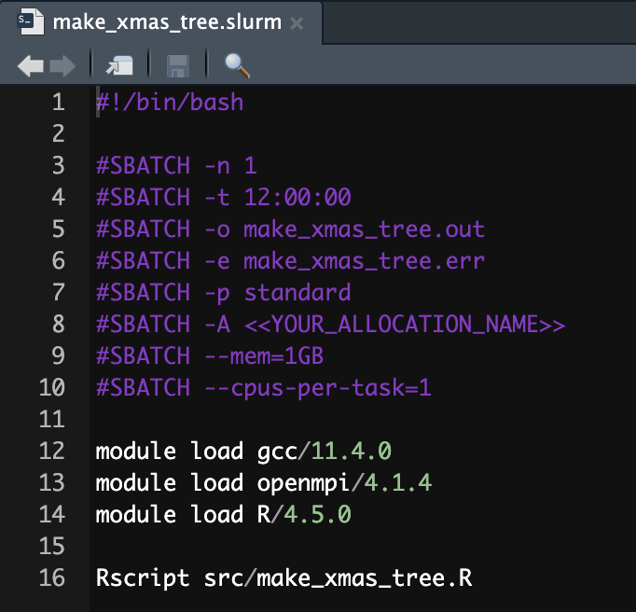
The slurm batch file

Slide 36
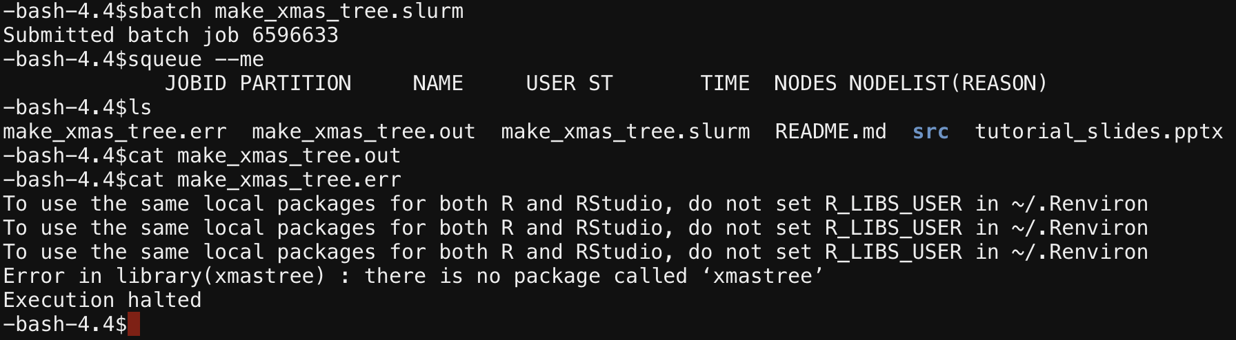
Submit the job

Slide 37
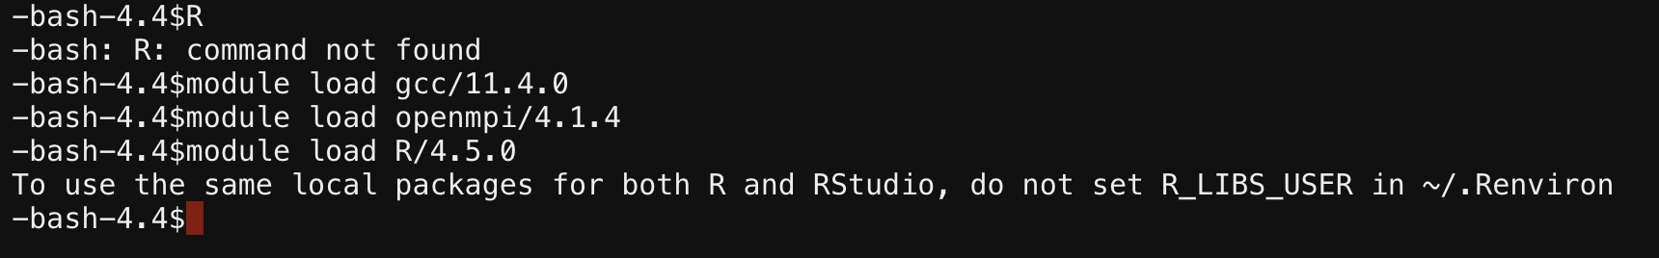
Load R

Slide 38
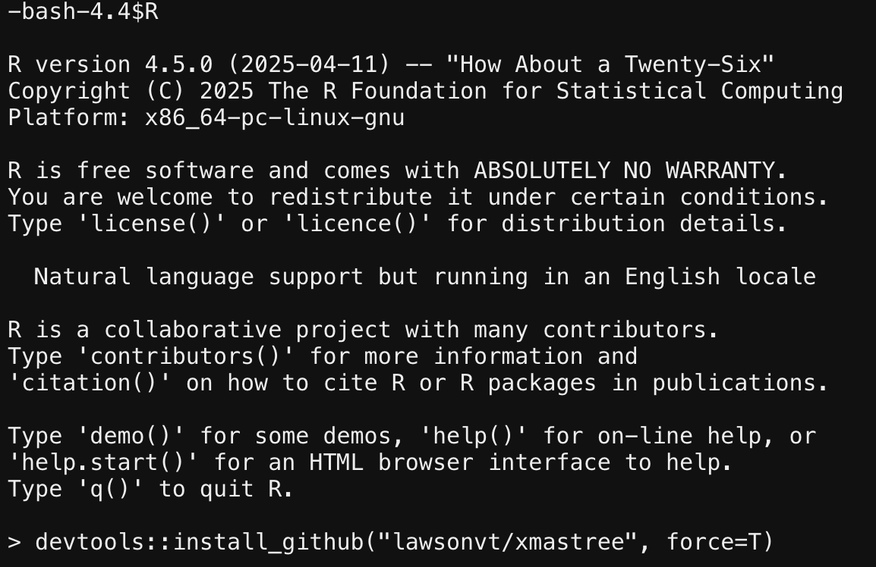
Install the missing R Package

Slide 39
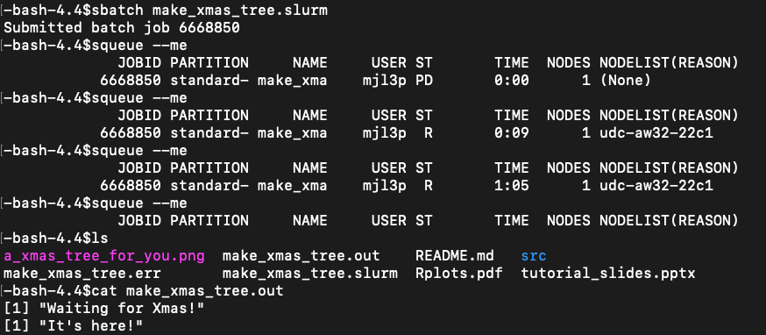
Submit the job again

Slide 40
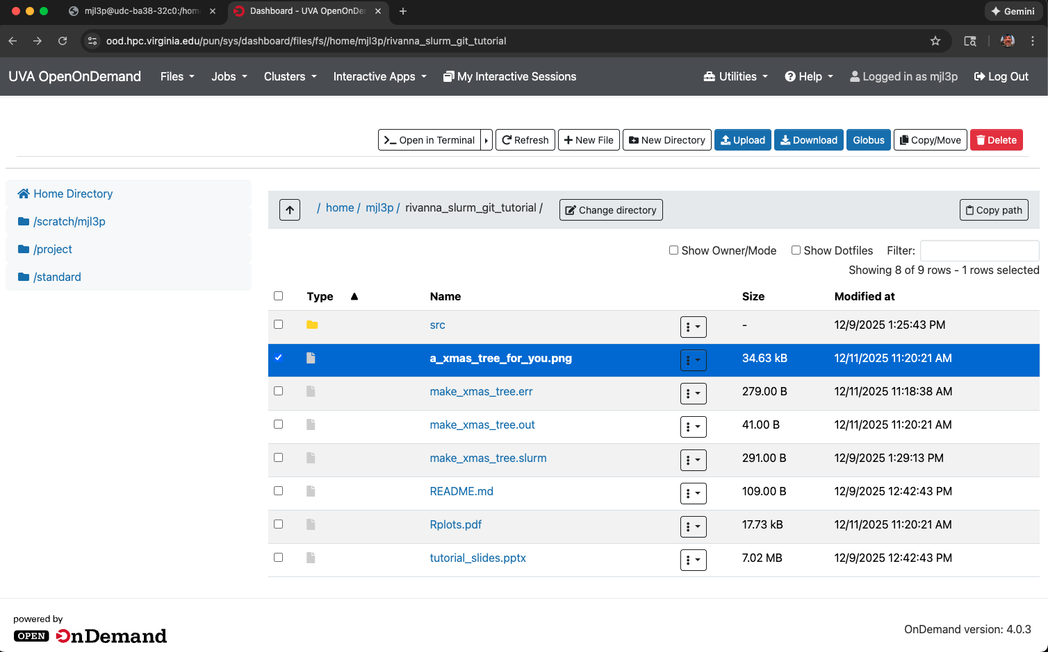
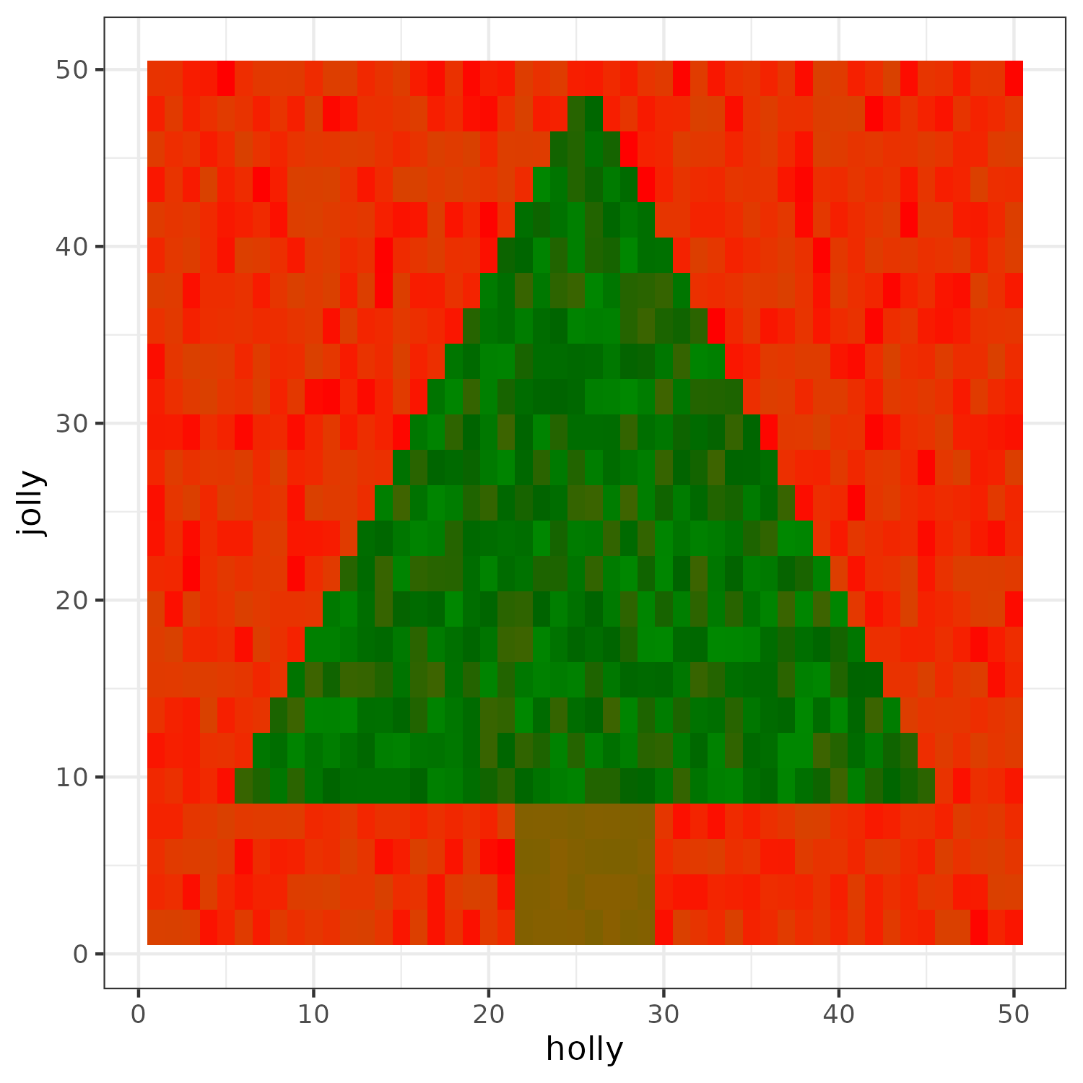
Find the tree!

Slide 41
Tips and Tricks
git / Github is only powerful if you actually use it! Not committing changes and not commenting on them makes the revision tools less effective
Before submitting a big job on Rivanna, make sure to test it on a subset of the data first (maybe even on your machine). This can save many a headache of having a job run for hours only for a single line of code to be wrong
UVA Research Computing has a ticketing system for help / issues and they are very responsive and helpful
I can also help too

Slide 42
Thank you and Happy Coding!

